Slide 1

Software Engineering
Stage 6
A practical approach to 'Secure Software Architecture' in Software Engineering
Ben Jones, Daniel Covassin & Peter Davis
9th or 10th December 2024

Slide 2
Acknowledgement of Country
I’d like to begin by acknowledging the Traditional Owners of the land on which we meet today, the Gadigal people of the Eora nation and pay my respects to Elders past and present.
They are the first engineers, teachers and learners on these lands.

Slide 3
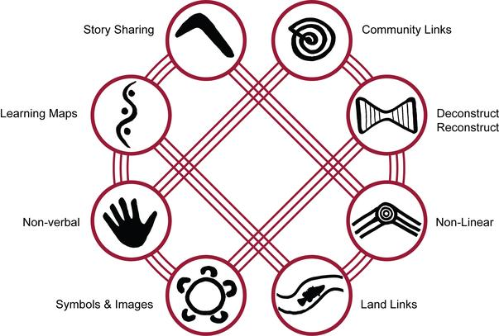
Connections to country
Aboriginal perspectives are not found in Aboriginal content, but Aboriginal processes...
https://ia.acs.org.au/article/2021/too-few-indigenous-people-in-tech.html

Slide 4
Agenda
1
6
Introduction & housekeeping
Online Examinations Discussion
2
7
Practical software security activities
Making VS Code work for you
3
8
Morning tea
GitHub and Flask
4
9
Overview of Python Flask
Cyber security presentation
5
Practical software security activities
10
Evaluation and close

Slide 5
Day Overview
A practical approach to 'Secure Software Architecture' in Software Engineering
A practical and hands-on day in a small group, supportive environment for teachers to build their confidence, skills and tools to deliver the NESA Software Engineering course. Focusing on the 2 focus areas ‘Secure Software Architecture’ and ‘Programming for the Web’.
The skills and tools can also be directly applied to supporting students with the design and development of their ‘Software Engineering Project’ or easily creating a user interface for ‘Software Automation’.

Slide 6
Introduction & housekeeping

Slide 7
Need to know
We are in room 8.05 on level 8
Toilets are …
We are in a respectful adult learning environment
Please be present (as we would say to the students, ‘phones {emails} are off and away’).
If a mobile call is essential, please take it outside.
Please respect all presenters and their time commitment today.
This session is designed for beginners. All questions are welcome and encouraged.

Slide 8
Making VS Code work for you

Slide 9
Learning intentions and success criteria
We are learning to:
Understand how Extensions can enhance VSCode IDE capabilities
Setup VSCode as a general-purpose IDE for Software Engineering
Create profiles so we can quickly change our environment for different contexts
We can:
Understand the benefits and limitations of extensions
Import a profile
Customise the IDE to suit our needs
Create a profile
Notes:
Overview the learning intentions and success criteria for the session

Slide 10
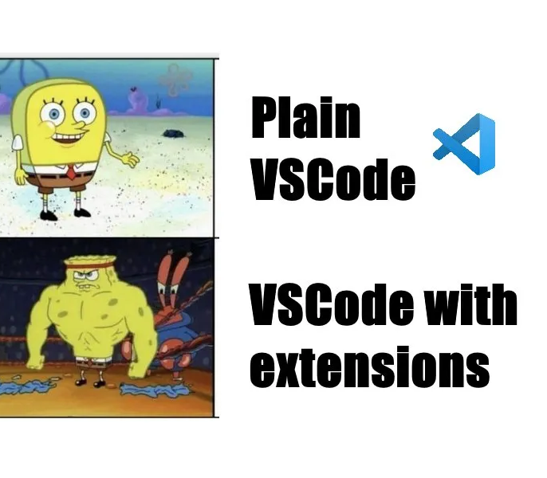
Making VS Code work for you
Why VSCode?
Wide industry use, 2nd most used IDE (15%) behind Visual Studio (25%)
A simple IDE with all the capabilities for the Software Engineering course
High extensible through extensions, settings and profiles
Formatting, linting, debugging, terminal, AI and version control integrated
Notes:
Visual Studio Code is a perfect general IDE for all Software Engineering Tasks. Some teachers will have skills and experience in C++ or C# and or specialised IDE’s and they are encouraged to use those IDE’s. This session is for teachers who are looking for a simplified IDE that can meet all Syllabus requirements and reduce the cognitive load of learning interfaces.

Slide 11
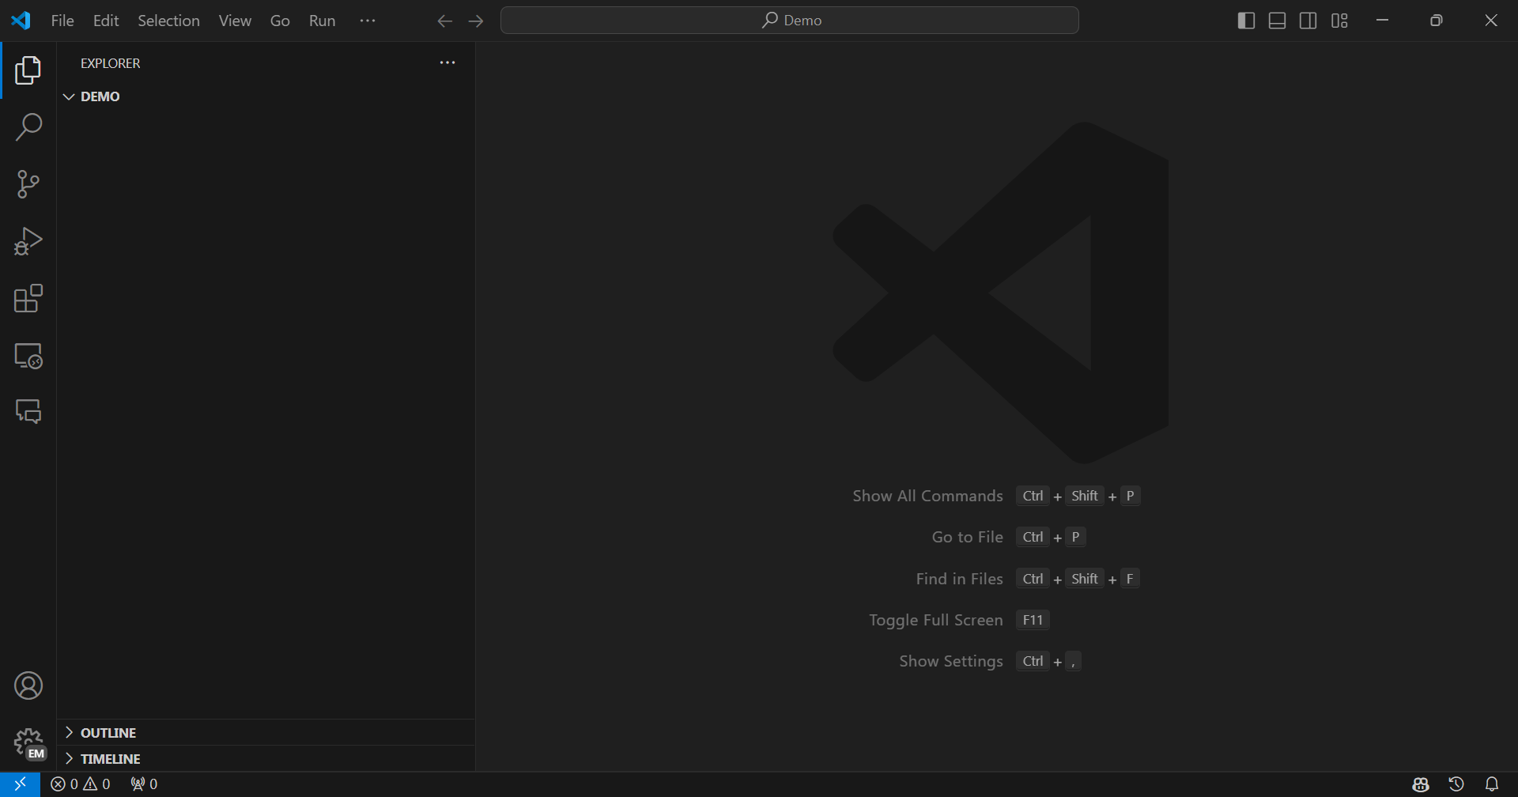
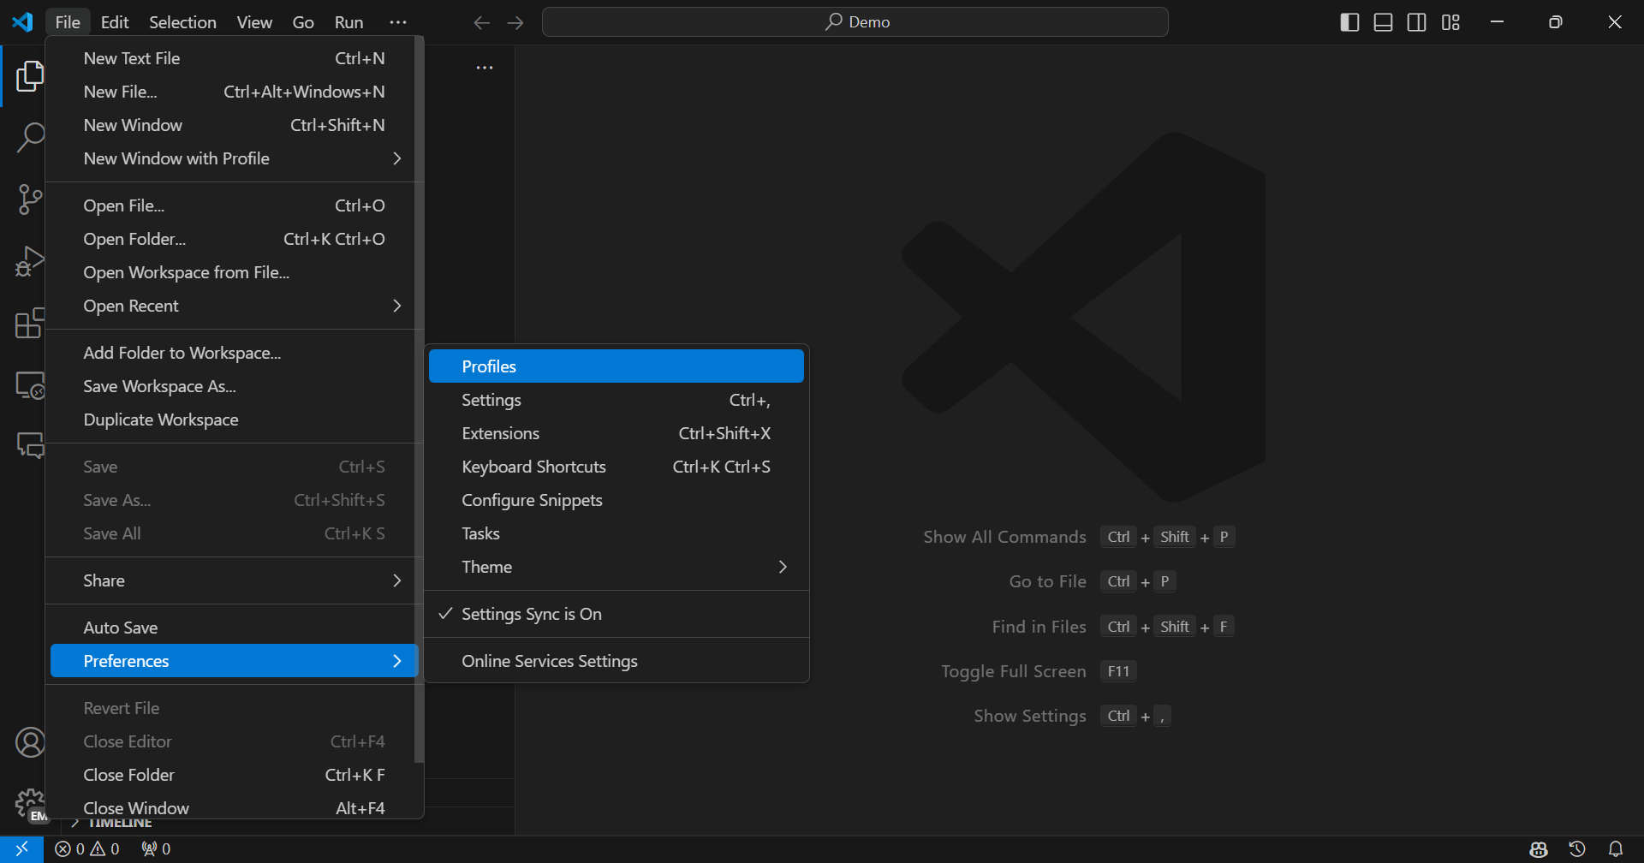
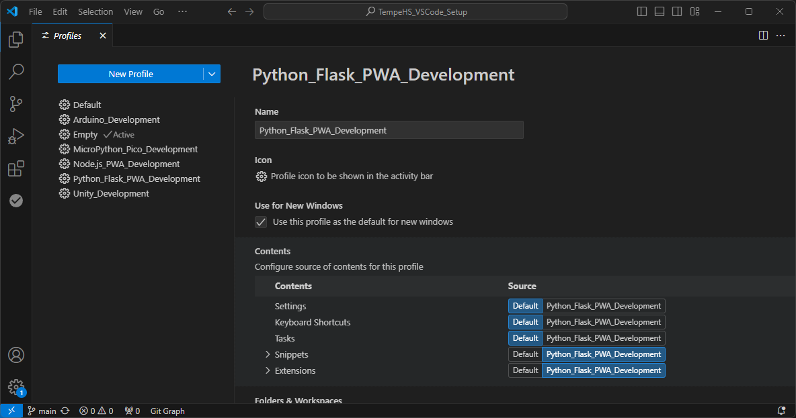
VSCode
Profiles and Extensions
Notes:
Explain how profiles work, and participants will create a new Python Flask specific profile

Slide 12
Essential Python Extensions
Enhance your development experience
Debugging – set breakpoints, step through code, inspect variables, and perform other essential debugging tasks. Python Debugger
Linting - basic static code analyser PyLint
Formatting - a tool that helps you improve the readability and maintainability of your code. Prettier (HTML, CSS, JS, JSON, etc) Black Formatter (Python)
Code support – a tool that provides performant language support. Pylance
Visual tools – a range of tools that visually improve the IDE or the readability of code. Indent Rainbow, Rainbow CSV, etc
IDE Functionality – a variety of tools that make the IDE more functional. SQLite3 editor, Thunder Client, etc
https://github.com/TempeHS/TempeHS_VSCode_Setup
Notes:
Explain the services and features of these key Python VSCode Extensions

Slide 13
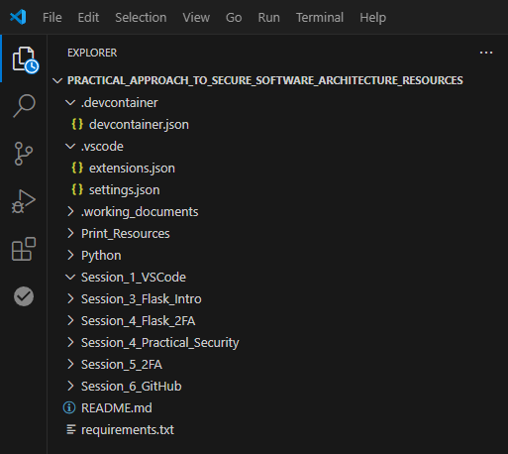
Auto configure VSCode & Codespaces
.devcontainer/devcontainer.json
Configure Codespaces including dependencies, extensions and ports
.vscode/extensions.json
Pre-fill extension suggestion list
.vscode/settings.json
Pre-configure workspace settings
requirements.txt
Dependencies to be installed by Codespaces
Notes:
Explain how the auto-configuration of VSCode and Codespaces can improve the experience of first-time coders in VSCode.

Slide 14
Install Requirements For Today
The easy way…
$ pip install -r requirements.txt

Slide 15
GitHub Codespaces
VSCode in the cloud
Demonstration of Codespaces: https://github.com/features/codespaces
GitHub Education: https://github.com/education
Notes:
Demo of Codepsaces and VSCode in the cloud

Slide 16
Overview of Python Flask

Slide 17
Learning intentions and success criteria
We are learning to:
Create a Flask application
We can:
Understand the Flask architecture
Apply the architecture to create a basic Flask application with endpoints
Understand the fundamentals of the Jinga2 template engine in Flask
Notes:
Overview the learning intentions and success criteria for the session

Slide 18
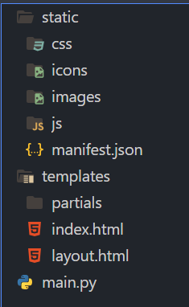
Flask Architecture
File structure
The static folder contents are served publicly
Today, PWA requirements and the Bootstrap frontend framework have already been built into the static folder to facilitate our rapid app development
The templates folder is the repository for dynamic HTML files with the Jinga2 template engine built-in
The main.py is the Flask App python implementation configuring endpoints and their HTTP request methods.
Other Python files (think machine learning, database interface, app services, etc, etc) can be added to the root of the project and called by main.py as you would any other Python abstraction.
Netflix, Uber, Airbnb, Reddit all use Flask
Notes:
Introduce the Flask architecture and folder structures for static and dynamic frontend components and the Python backend implementation.

Slide 19
Flask
Install
$ pip install flask
Notes:
Install the flask dependencies

Slide 20
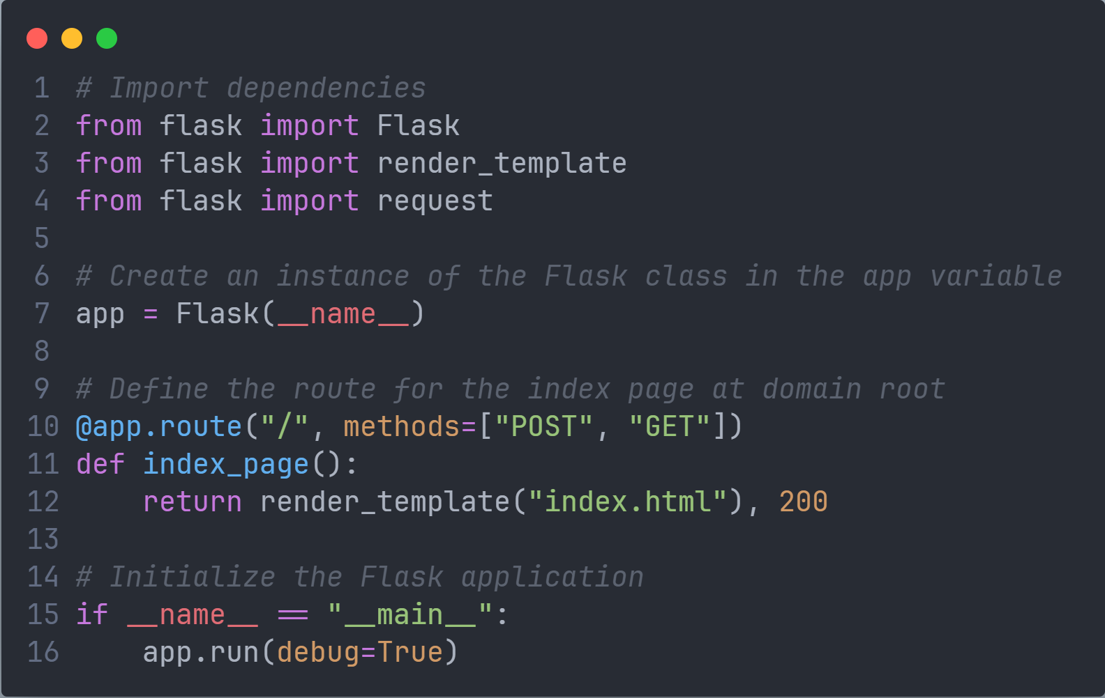
Notes:
Setup main.py
Explain the dependencies, instantiation, endpoint configuration and initiation.

Slide 21
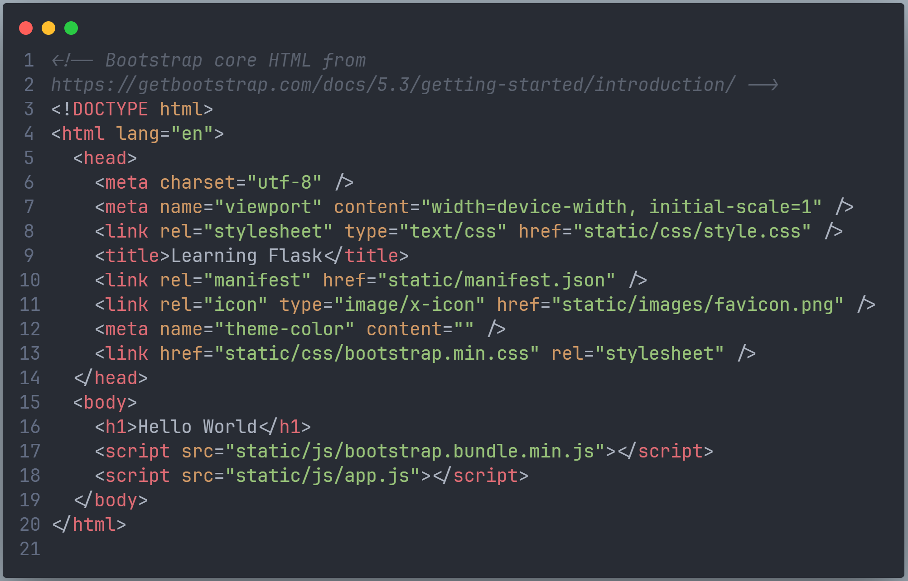
Notes:
Setup templates/index.html
Explain the render_template library defines the templates folder name

Slide 22
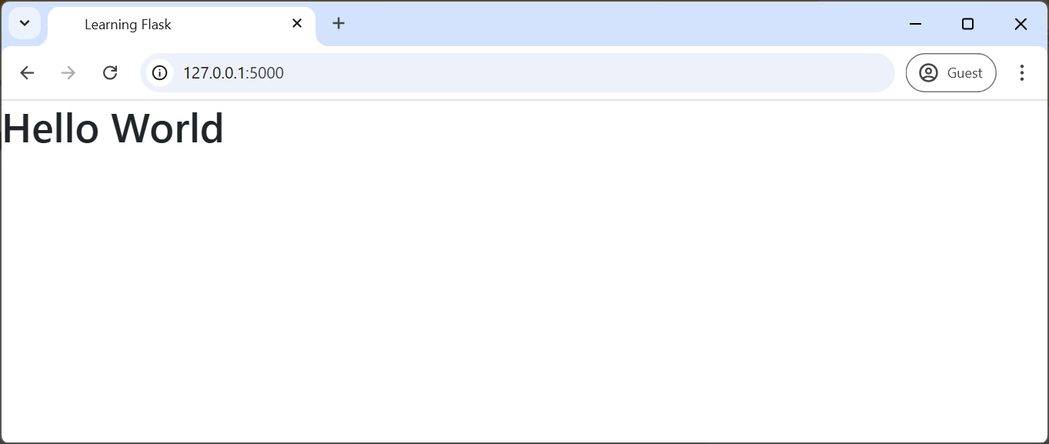
Testing
Test: basic HTML and domain root GET request
Execute the Python
$ python main.py
Navigate to
http://127.0.0.1:5000/
Inspect:
Browser developer tools console
Terminal
Notes:
Test the domain root endpoint.
Demonstrate the developer tools and terminal for debugging a Flask app.

Slide 23
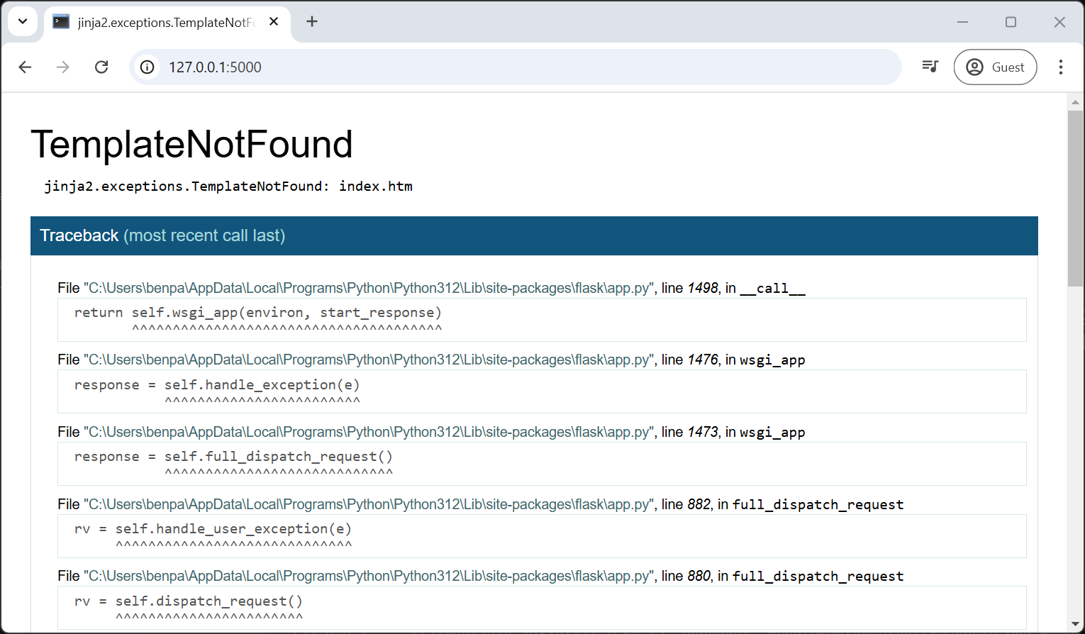
Debugging Flask
Tools
Force a runtime error
$ python main.py
Navigate to http://127.0.0.1:5000/
Debugging Tools
Terminal – Webserver and event log
Browser developer tools – Frontend
Traceback - Runtime
VSCode debugging tools – General debugging
Compiler error
They will generally cause a terminal error, and Flask will need to be re-initialised from the terminal
$ python main.py
Notes:
Demonstrate the traceback tool for debugging a runtime error
Explain the different debugging tools
Explain the terminal effect of a compiler error

Slide 24
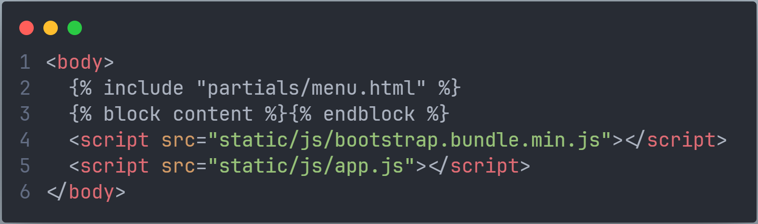
Notes:
Rename the index.html to layout.html
Change the <body></body> to add the Jings2 partials and block content and explain how Junga2 partials and block content work.

Slide 25
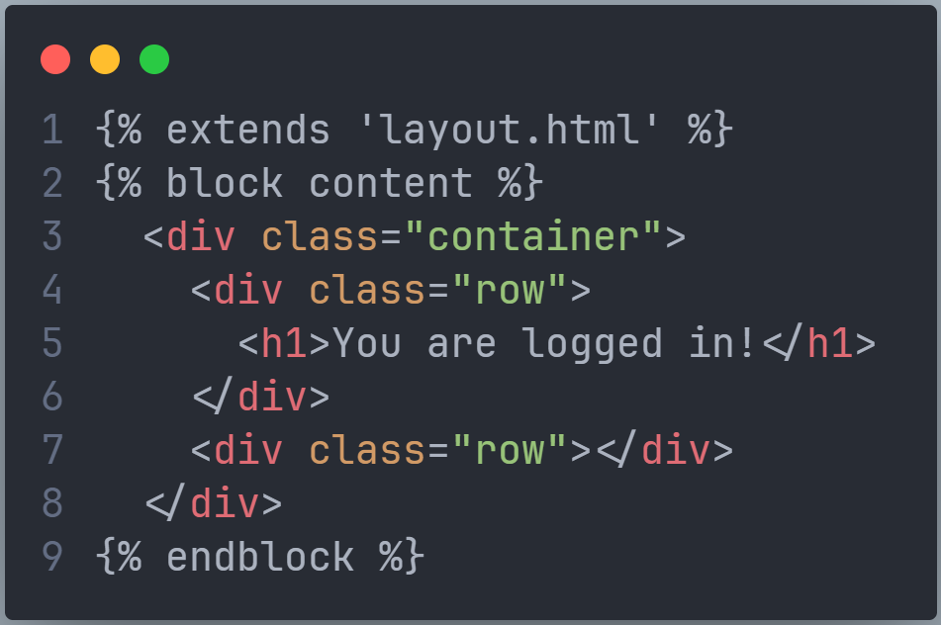
Notes:
Create a new index.html
Explain the extend and block content Jinga2
Create a partials/menu.html
Copy the basic navbar from https://getbootstrap.com/docs/5.3/components/navbar/

Slide 26
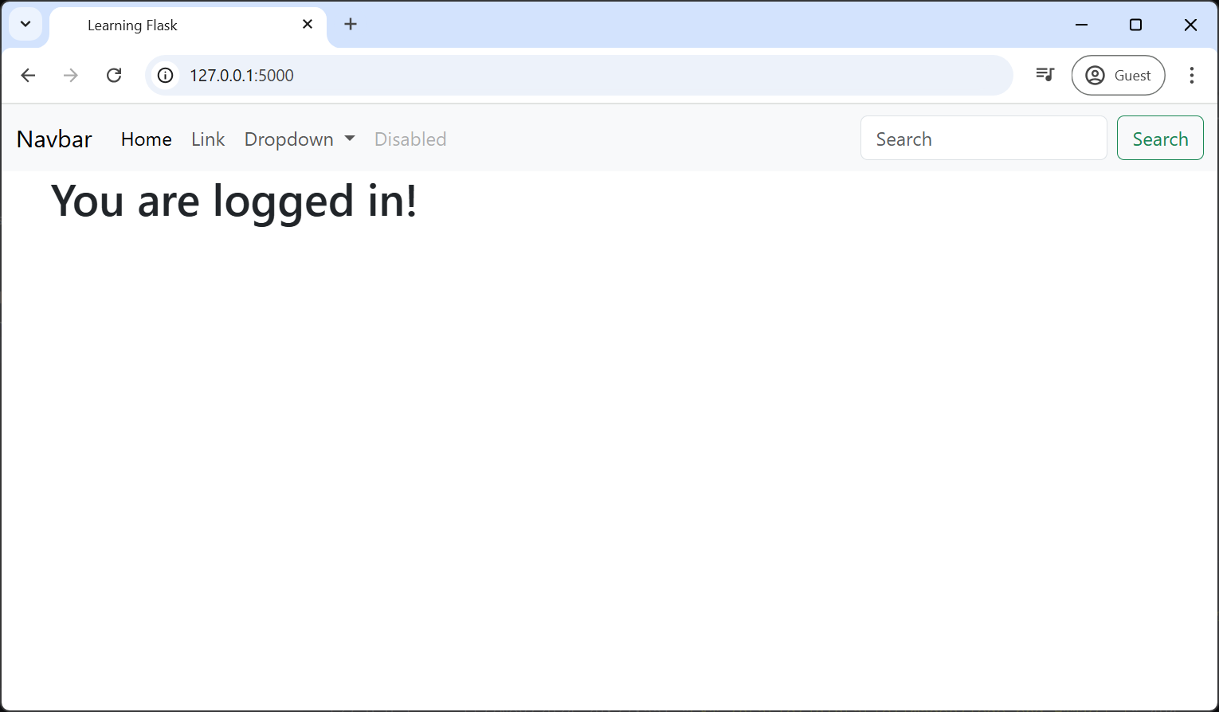
Testing
Test layout template with menu partial and index block
Execute the Python
$ python main.py
Navigate to
http://127.0.0.1:5000/
Inspect:
Developer tools source
Notes:
Test the layout template, index block and menu partial.
Inspect the developer tools source to show how the Jinga2 constructs the page.

Slide 27
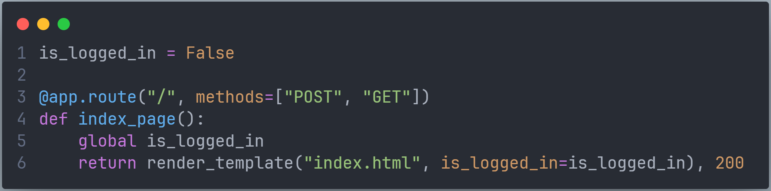
Notes:
Declare POST and GET request methods to the endpoint
Add a Boolean to manage logged in/out state
Pass the Boolean to the index.html template.
Explain that any data can be passed to render template including JSON, dictionaries, tuples, variables, files, API responses, etc

Slide 28
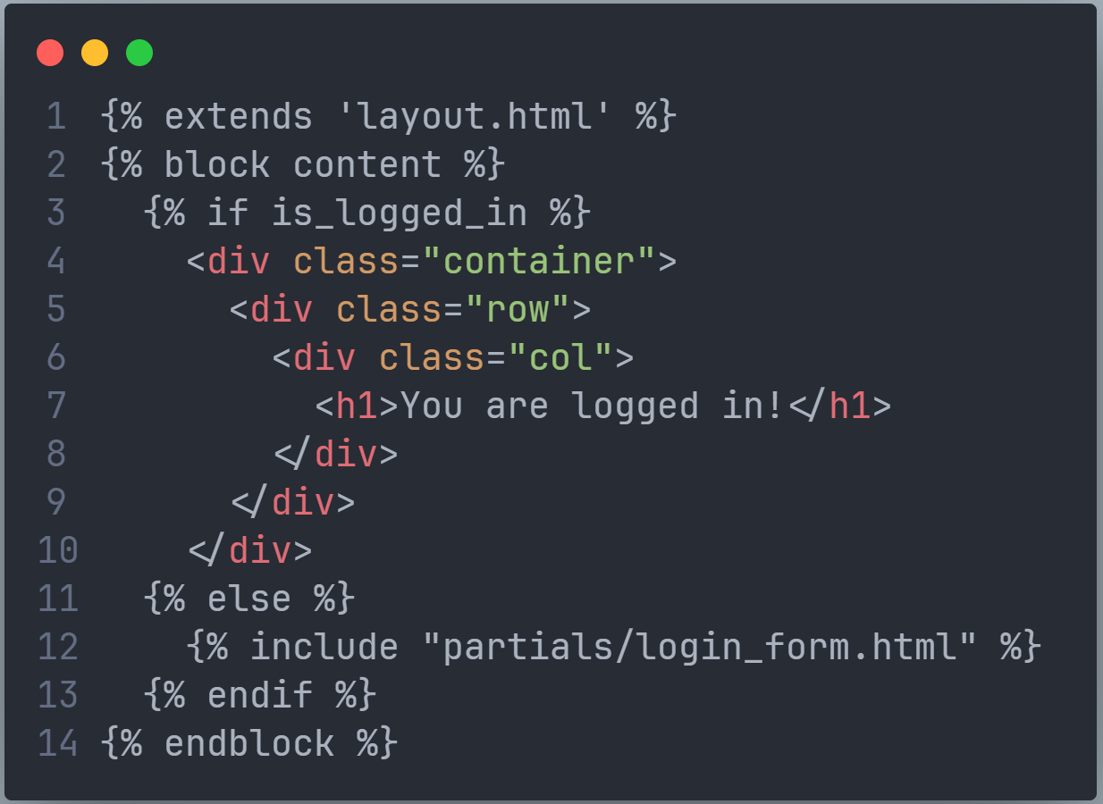
Notes:
Add some Jinga2 logic to the index.html
Explain that Jinga2 has the common selection and iteration logic built-in
Add the login form partial
Explain the use of partials to abstract front-end elements for easy maintenance and reuse

Slide 29
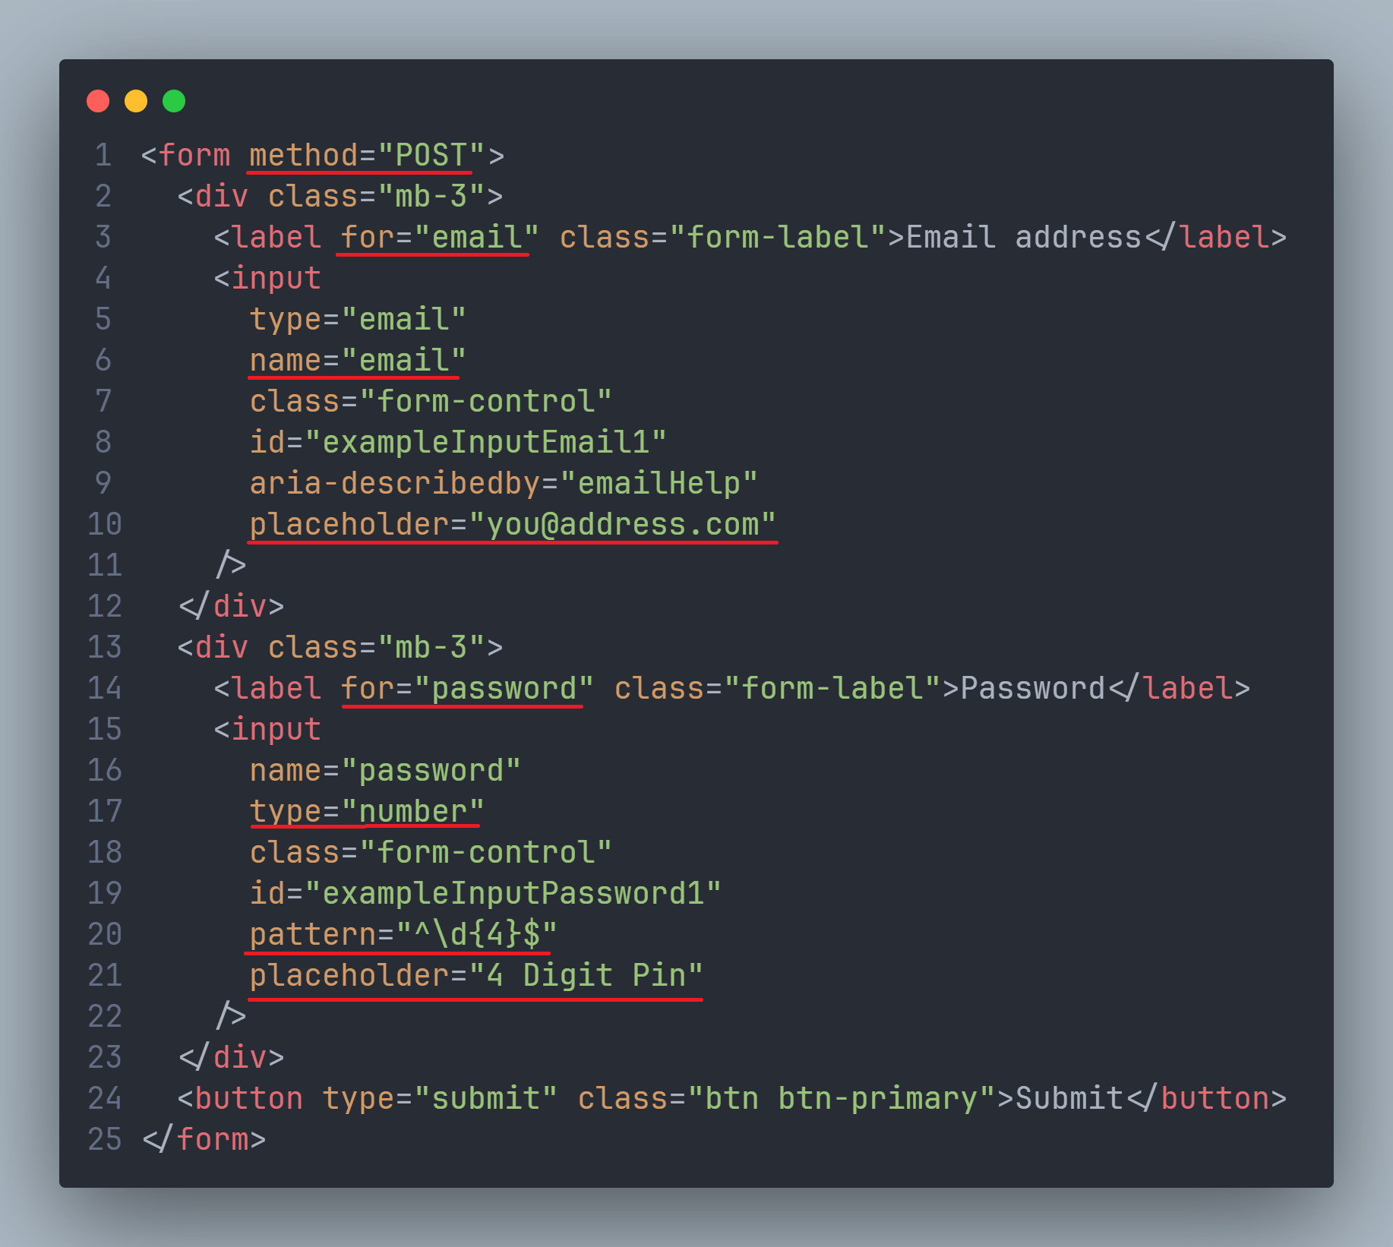
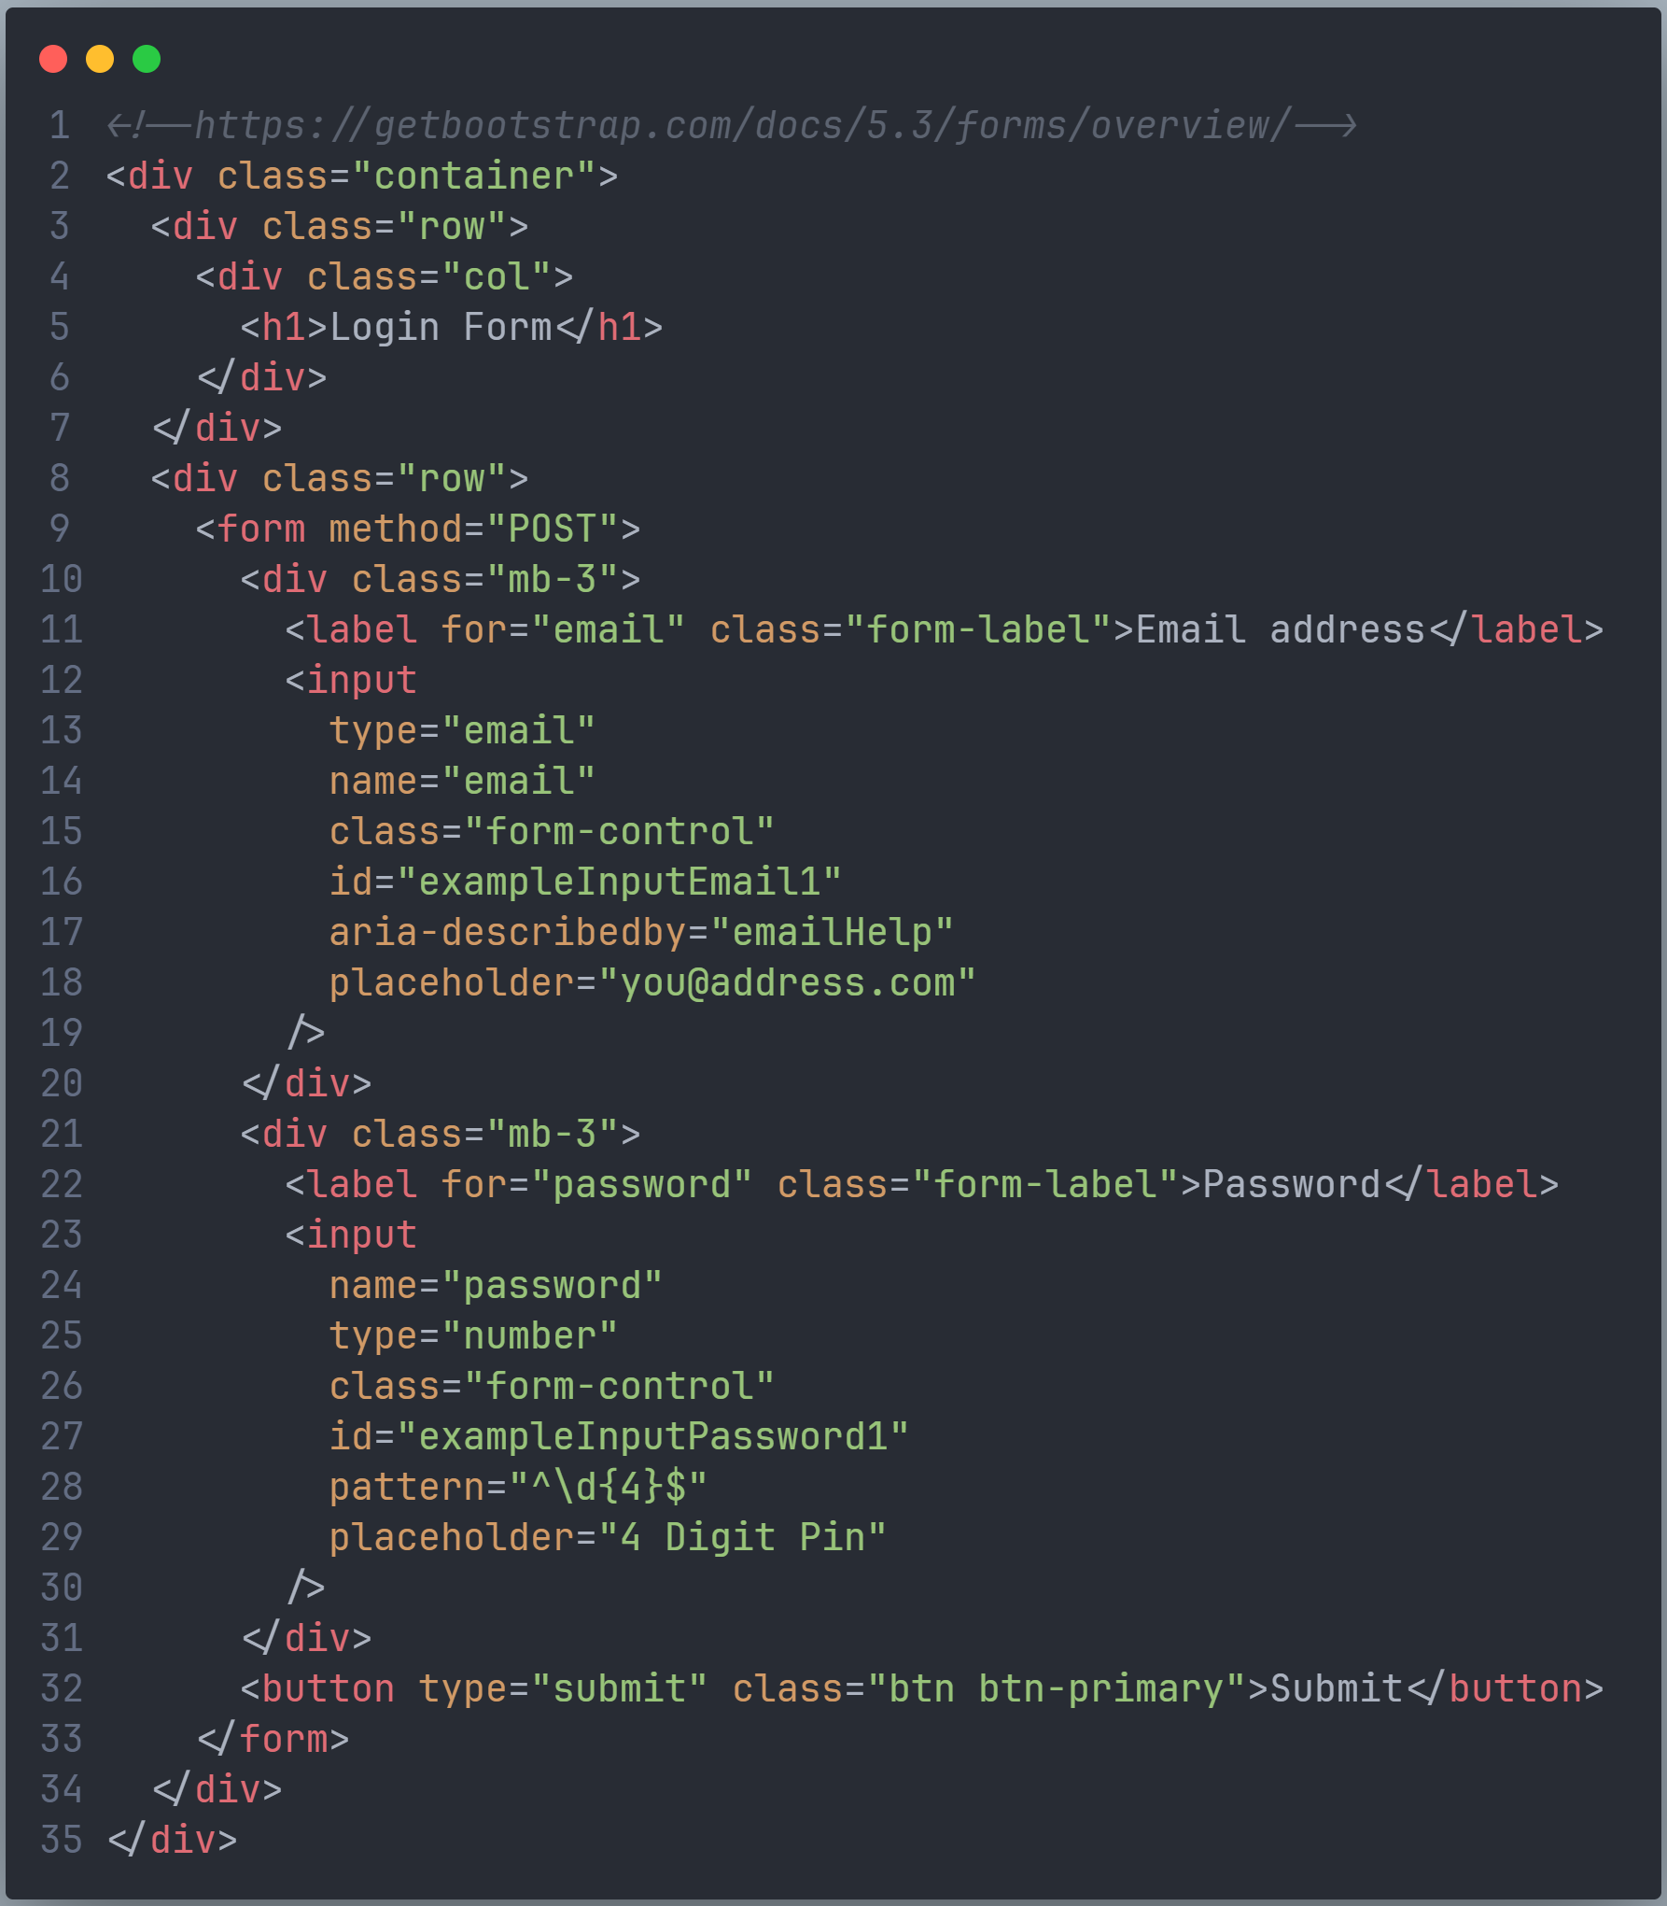
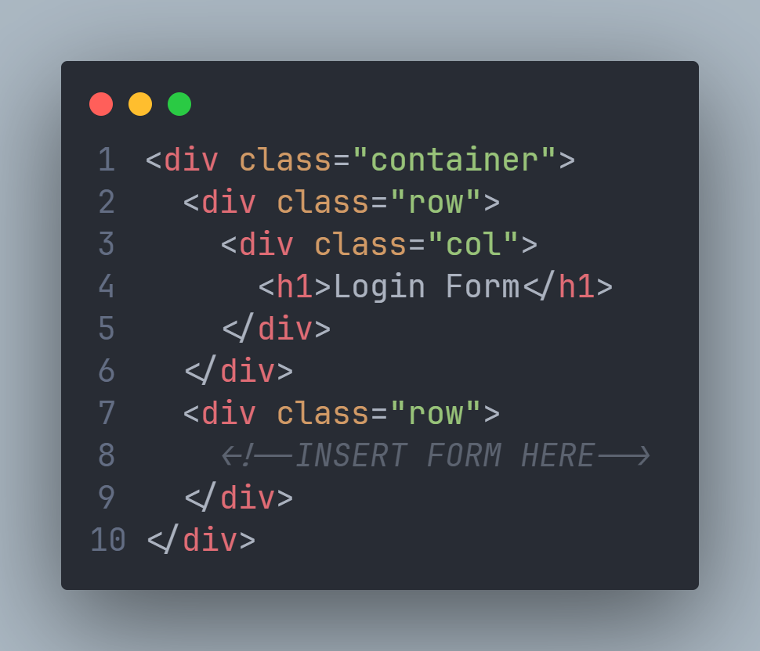
Notes:
Build the login form using Bootstrap forms: https://getbootstrap.com/docs/5.3/forms/overview/
Explain the “name” is the attribute used by Python Flask

Slide 30
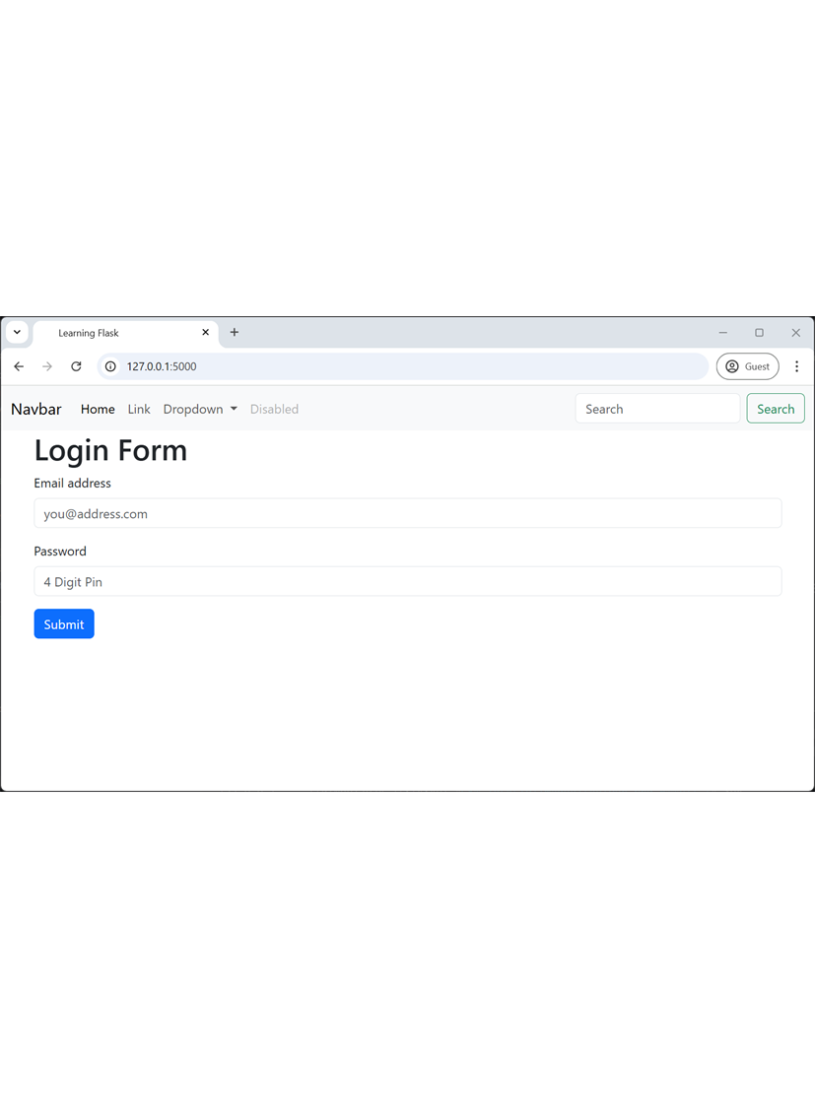
Testing
Test login user experience
Execute the Python
$ python main.py
Navigate to
http://127.0.0.1:5000/
Force value
is_logged_in = True
Navigate to
Navigate to http://127.0.0.1:5000/
Notes:
Test the login user experience by manually changing the value of is_logged_in

Slide 31
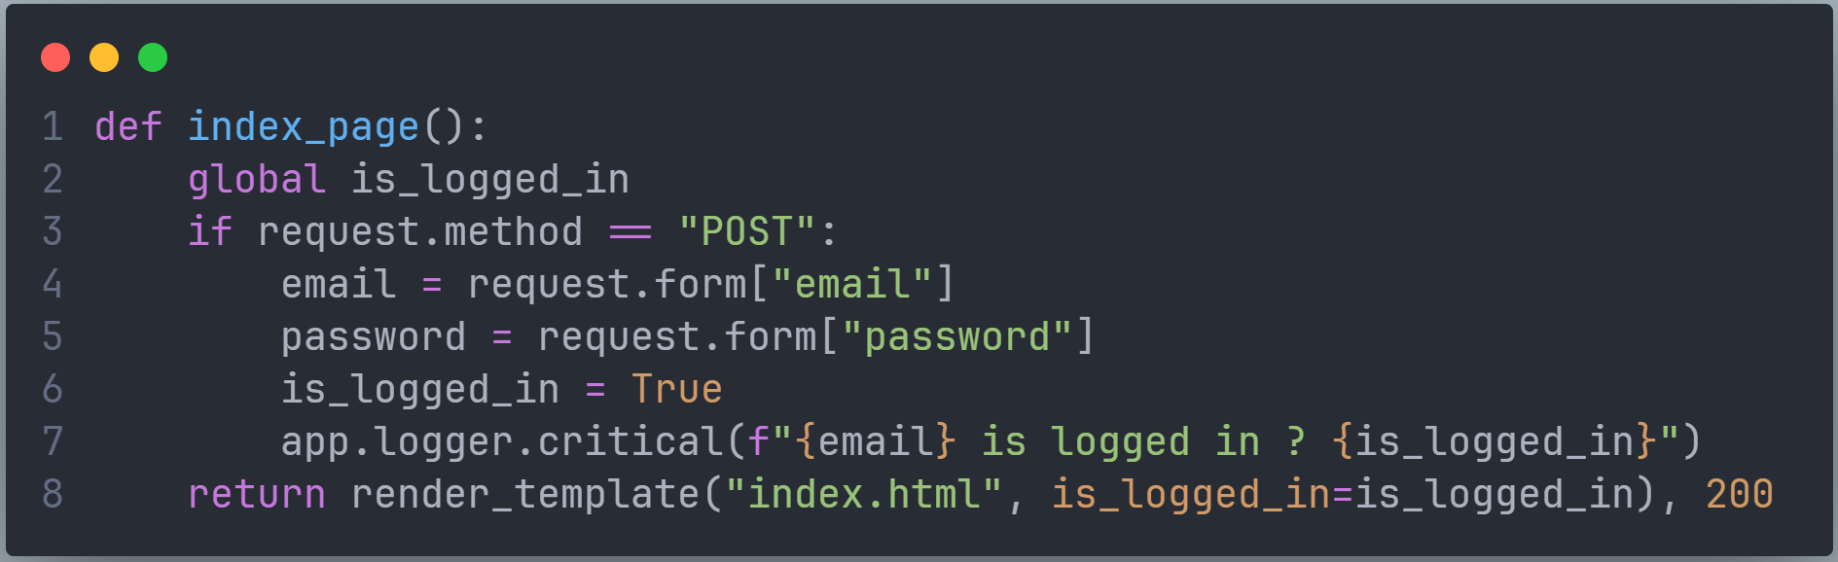
Notes:
Extend the index_page() method to store the form data as variables and log then to the terminal for debugging purposes.

Slide 32
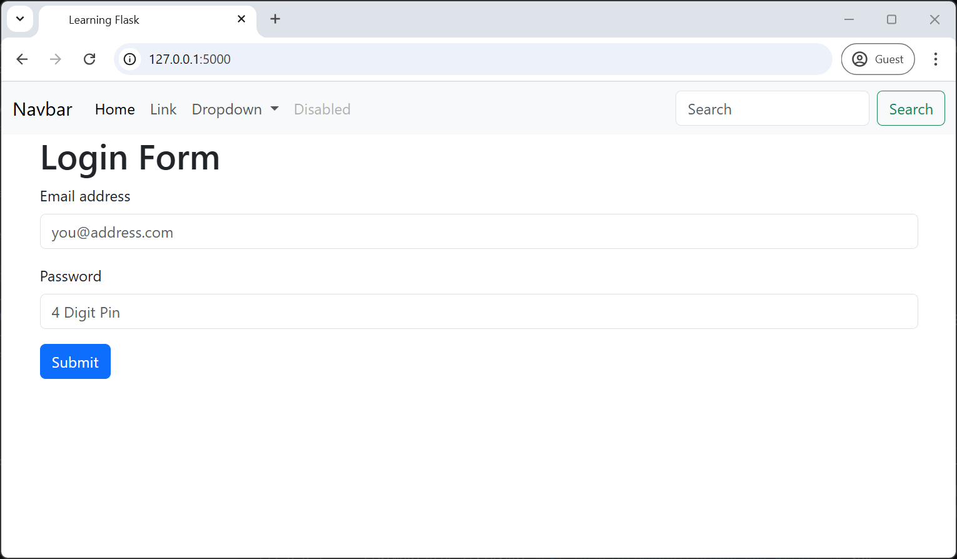
Testing
Test login
Execute the Python
$ python main.py
Navigate to
http://127.0.0.1:5000/
Test script
Enter invalid data and submit to test front-end validation
Enter a valid email and 4-digit password and submit to test authentication
Inspect:
Terminal
Notes:
Test the POST request and confirm the values in the terminal log

Slide 33
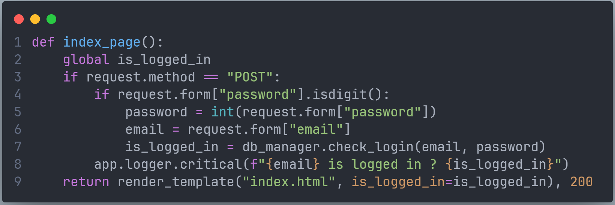
Notes:
Extend the index_pag() method to pass the email and username to the db_manger for authenticating

Slide 34
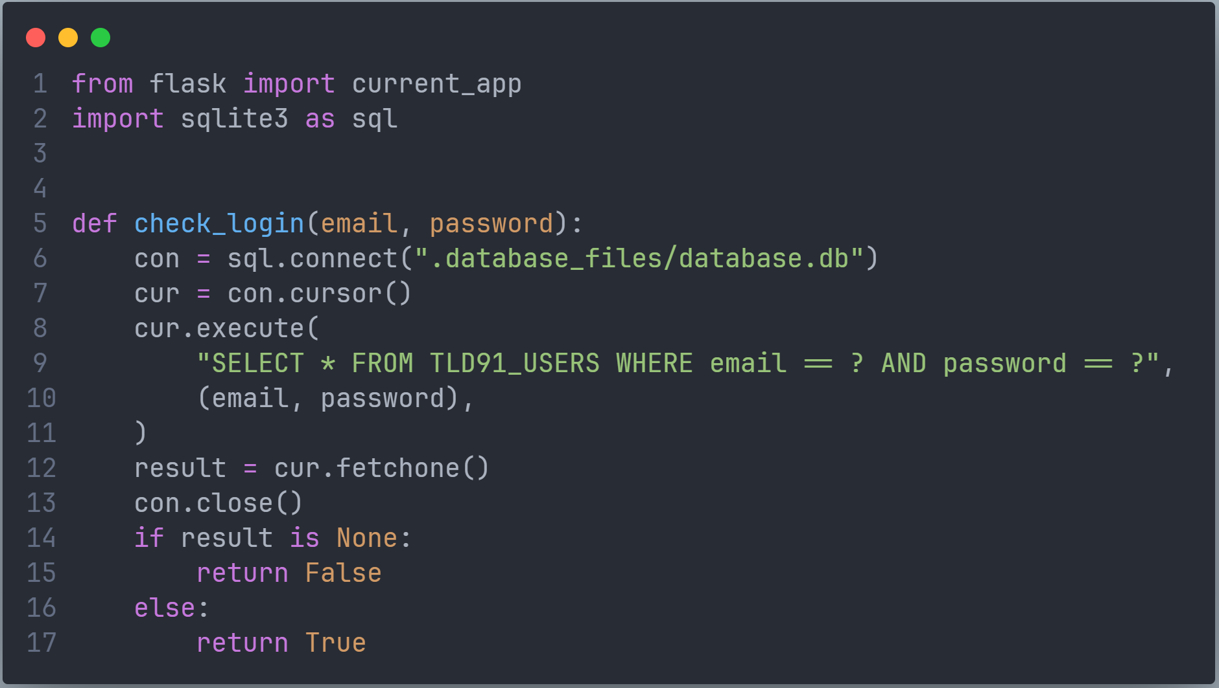
Notes:
Implement a binary comparison of the form values to the user database.
Explain that for further implementation more exception handling and salting and hashing of passwords is required.
Explain the importing of “import current_app” allows debugging values to the terminal.

Slide 35
Testing
Test login
$ python main.py
Navigate to http://127.0.0.1:5000/
Enter a valid email and 4-digit password that is not in the database and submit the form
Enter a valid email and 4-digit password that is in the database and submit the form
Inspect:
Terminal
Notes:
Test the final app.

Slide 36
Practical software security activities

Slide 37
Learning intentions and success criteria
We are learning to:
Develop knowledge of the architecture of vulnerabilities listed in the syllabus
Deconstruct the code that enables the vulnerabilities listed in the syllabus
Identify countermeasures to the vulnerabilities listed in the syllabus
We can:
Describe the architecture, code and countermeasures of vulnerabilities listed in the syllabus
Use the structure to explicitly teach our students
Notes:
Overview the learning intentions and success criteria for the session

Slide 38

Architecture, Code & Countermeasure
Understanding the vulnerability
Architecture: What is the structure of the vulnerability, including the people involved?
Code: At the code level, what does the exploit or vector look like, and what code patterns enable the vulnerability?
Countermeasure: What can be done to reduce the likelihood of the exploit or vector?
Notes:
Introduce session: as a whole group, we will discuss the ‘Architecture’ of each vulnerability and then look at some code samples. Then in small groups discuss countermeasures and the report back to whole group.

Slide 39
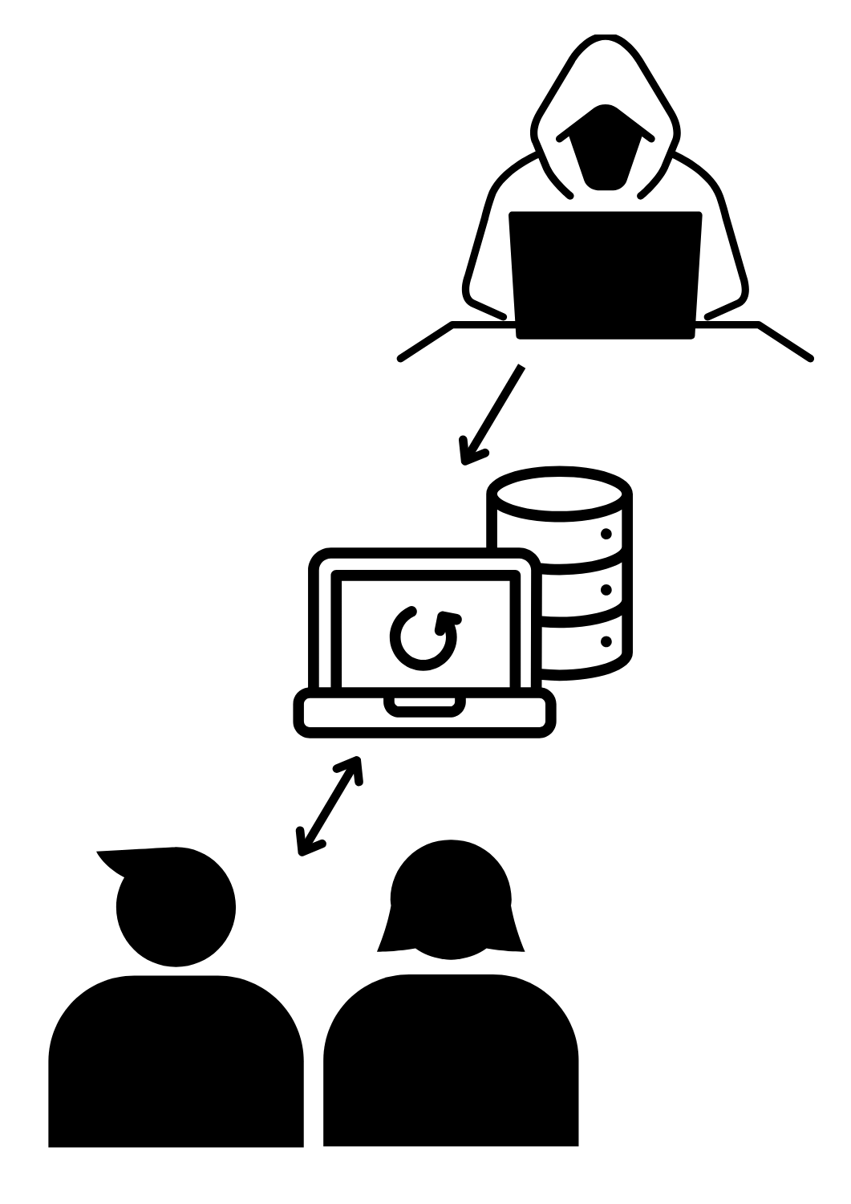
Cross-Site Scripting XXS
Architecture
1. A threat actor inserts a malicious script into a website by:
SQL injection into a known database structure that forces script into head HTML.
JS injection into form with insufficient defensive data handling
Hijacked library, plugin or extension
Sharing a hyperlink with a script attached or redirect to a hyperlink and script
2. The victim visits the website, and the script is executed.
3. The malicious script may:
Downloads a more malicious program
Change the use interface or experience
POST data from the UI to another website
Notes:
Introduce XXS and the role of the threat actor and victims.

Slide 40
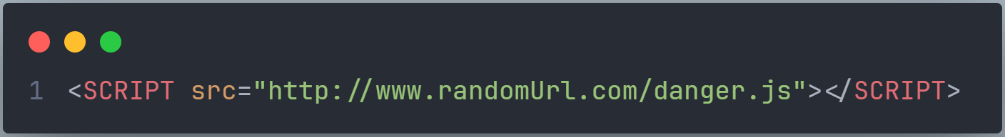
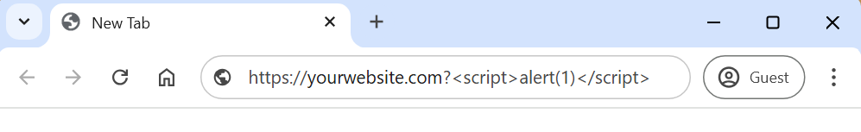
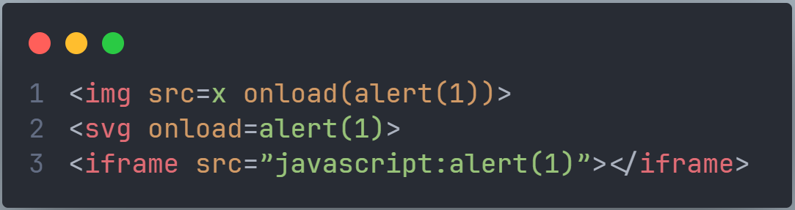
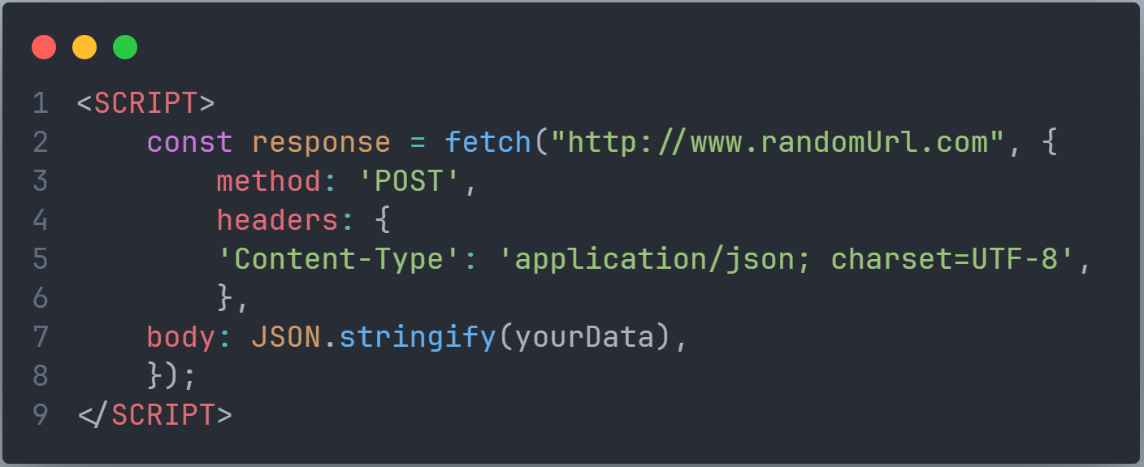
Cross-Site Scripting XXS
Code
Notes:
Talk through the three snippets focusing on what students should know and understand relating to user action controls:
Malicious script can be an <iframe>, <script>, <svg> and document event in any tag.
Charset & language not declared can be exploited by the exceptions caused by different characters.

Slide 41
Cross-Site Scripting
Countermeasures
Regular code reviews and implement static application security testing (SAST).
Implement defensive data handling.
Implement a strict head meta and server-side Content Security Policy (CSP).
Only known and secure third-party libraries should be externally linked. Preferably, after a code review, third-party libraries should be locally served.
Monitor 3rd party libraries for known vulnerabilities and, on discovery, patch the vulnerabilities.
Declare the language <html lang="en">.
Declare charset <meta charset="utf-8">.
Consider DOM order of execution when loading user-provided content
Notes:
Discuss different countermeasures to XXS

Slide 42
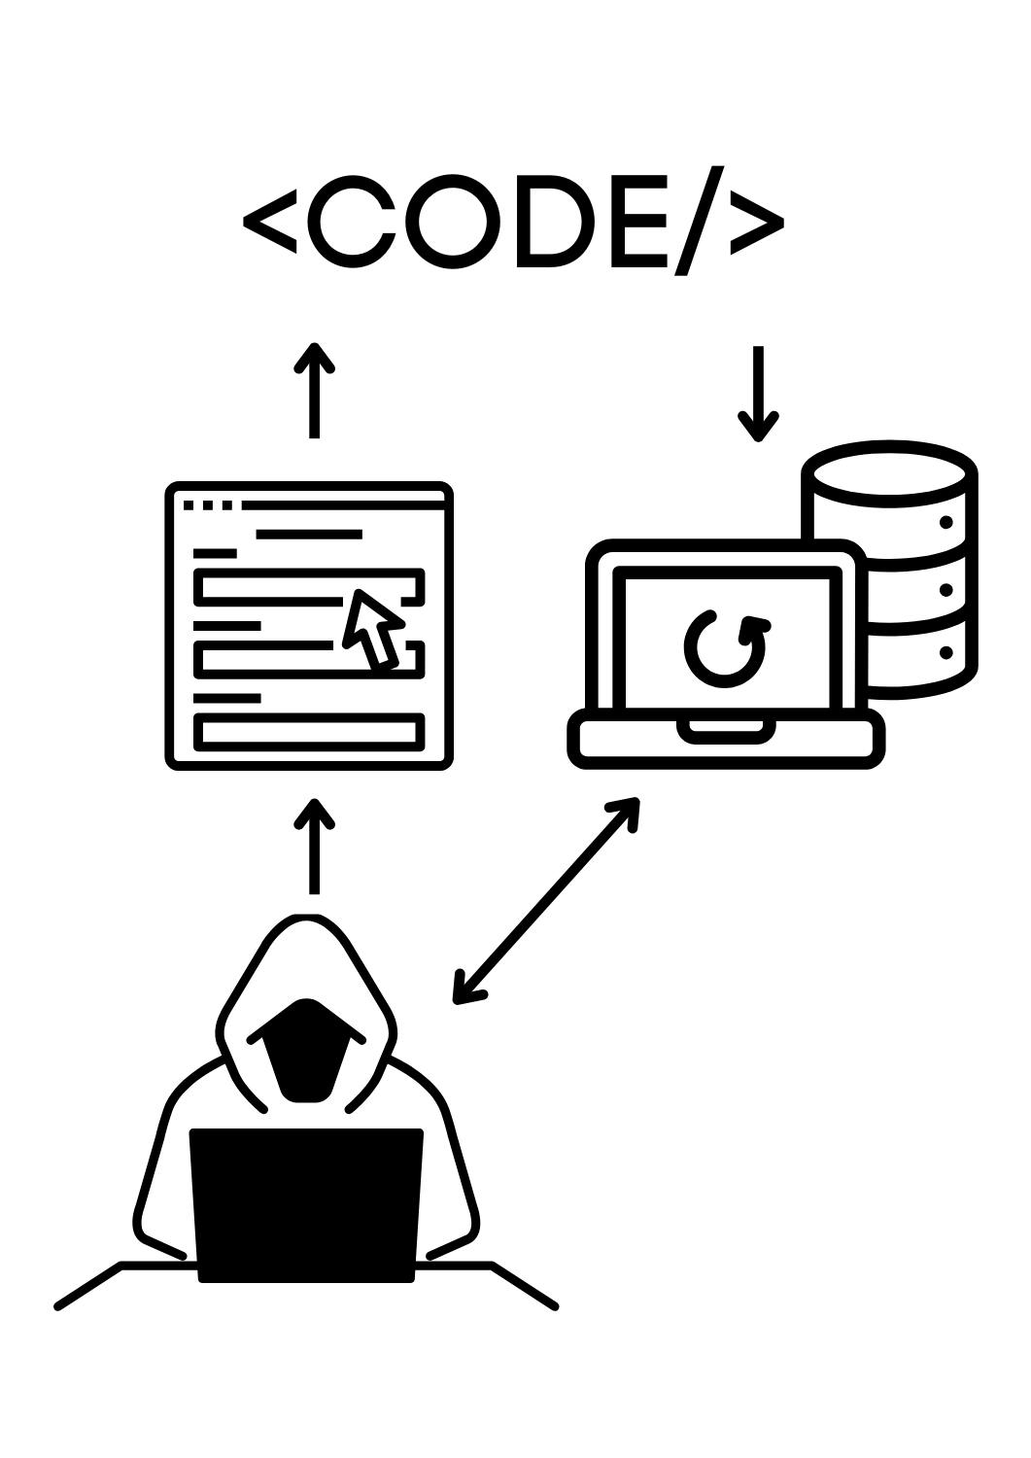
SQL Injections
Architecture
The threat actor constructs form inputs that are SQL commands and variables to control the application.
By the user controlling the inputs, they can:
Force an equality check to return true to gain access to authenticate or escalate authority.
Destabilise an application by dropping a table.
If the table structure is known or obvious (users, wp_posts, etc), insert malicious content that will be loaded into a session by all users.
Notes:
Introduce SQL injections and how threat actors can exploit poorly structured code to control user inputs.

Slide 43
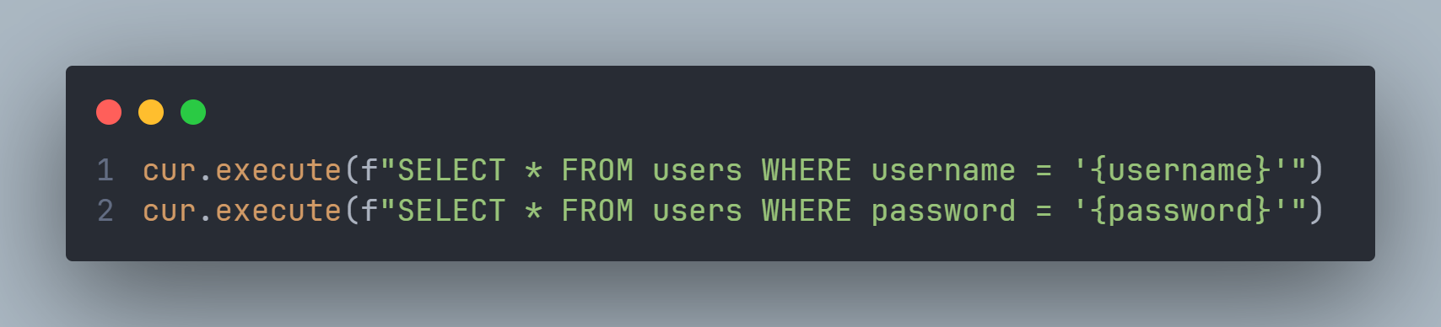
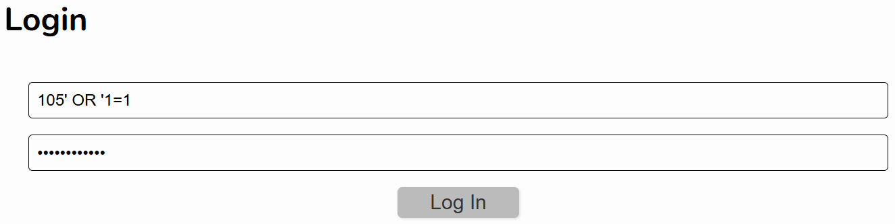
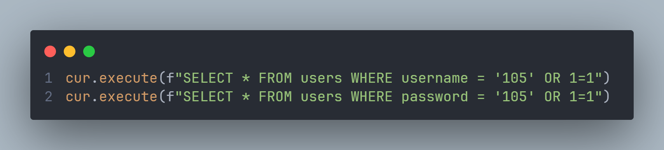
SQL Injections
Code
Notes:
Explain how user action controls are enabled because of concatenation and binary comparison and the impact can be exacerbated when UNION is allowed by the SQL server.

Slide 44
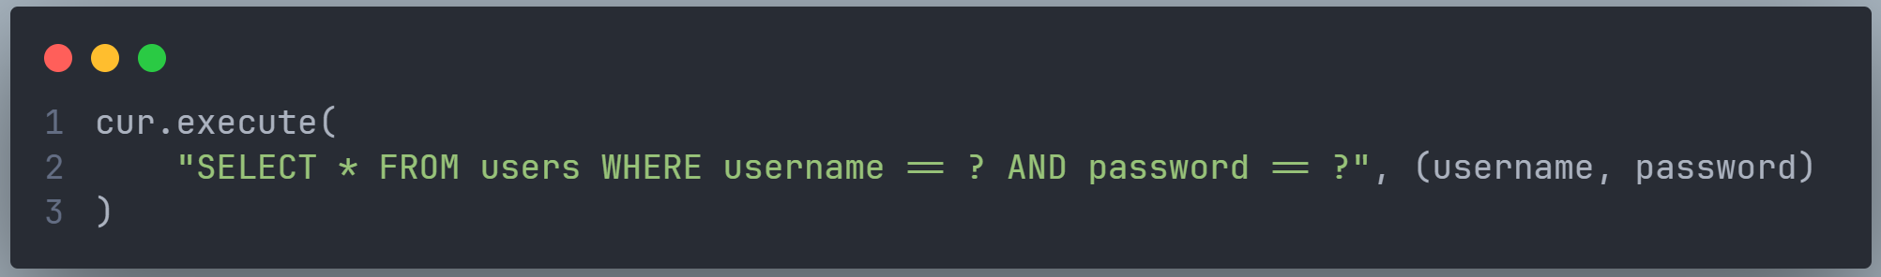
SQL Injections
Countermeasures
Regular code reviews
Update backend languages (Most versions of PHP are vulnerable)
Implement an API with built-in security as the interface to the SQL database
Implement Defensive data handling
Limit input length
Require authentication before accepting any form of input
Never construct queries with concatenating and binary comparison. Rather use query parameters, i.e.
Salt database table names with a 5-character random string
Notes:
Discuss different countermeasures to SQL injections.

Slide 45
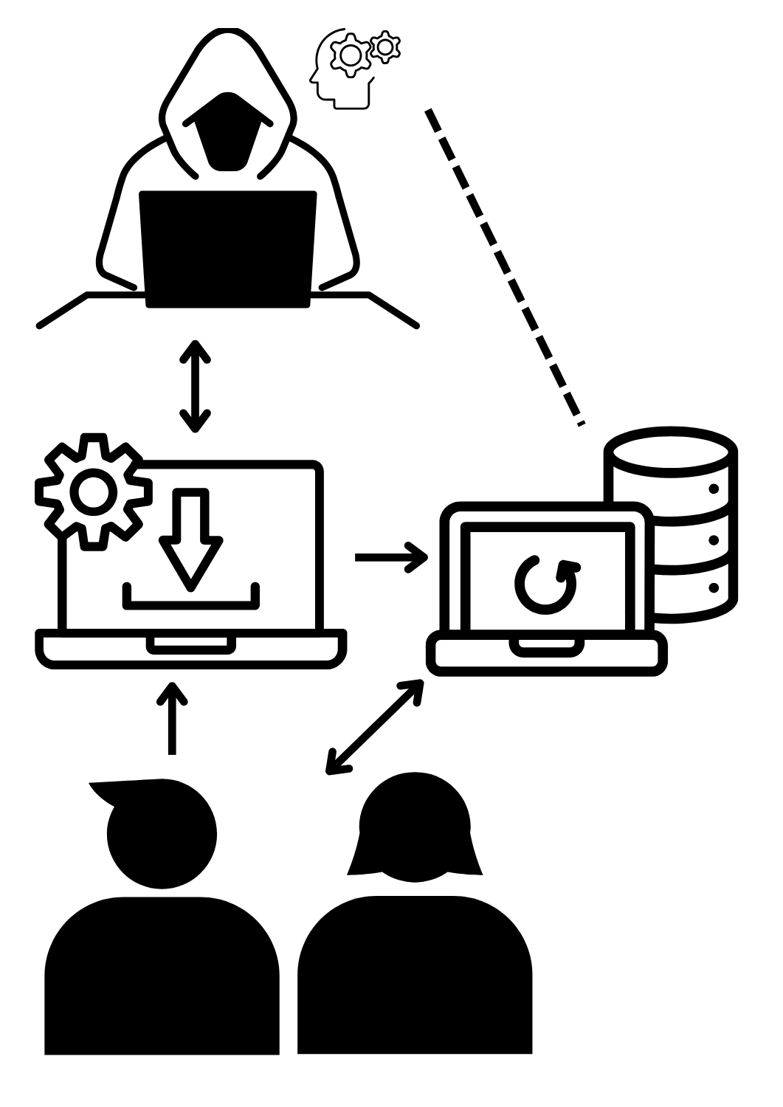
Cross-Site Request Forgery
Architecture
The treat actor applies their knowledge of a system to design a script.
The script is packaged in a deceptive format, usually as a trojan webpage or file attack.
The malicious package contains the forgery HTTP request.
The victim end user unknowingly executes the HTTP request, forcing unwanted actions on an application in which they’re authenticated
Notes:
Introduce CSRF focusing on the requirements for the threat actor to have business intelligence at the target application and the HTTP “request” that is forged.

Slide 46
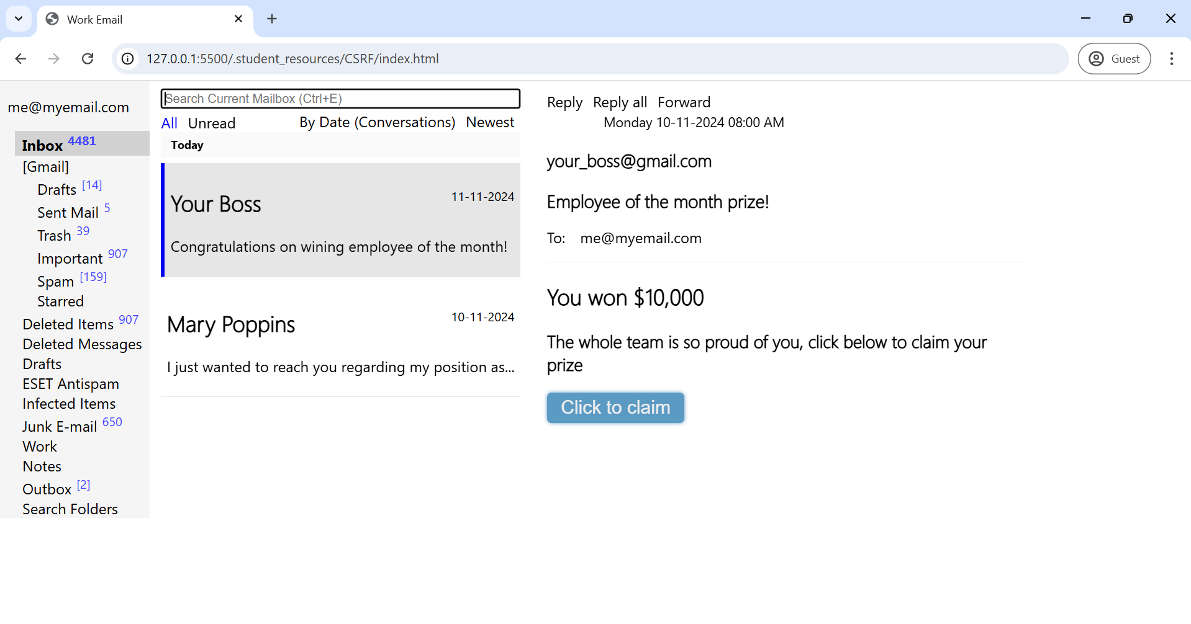
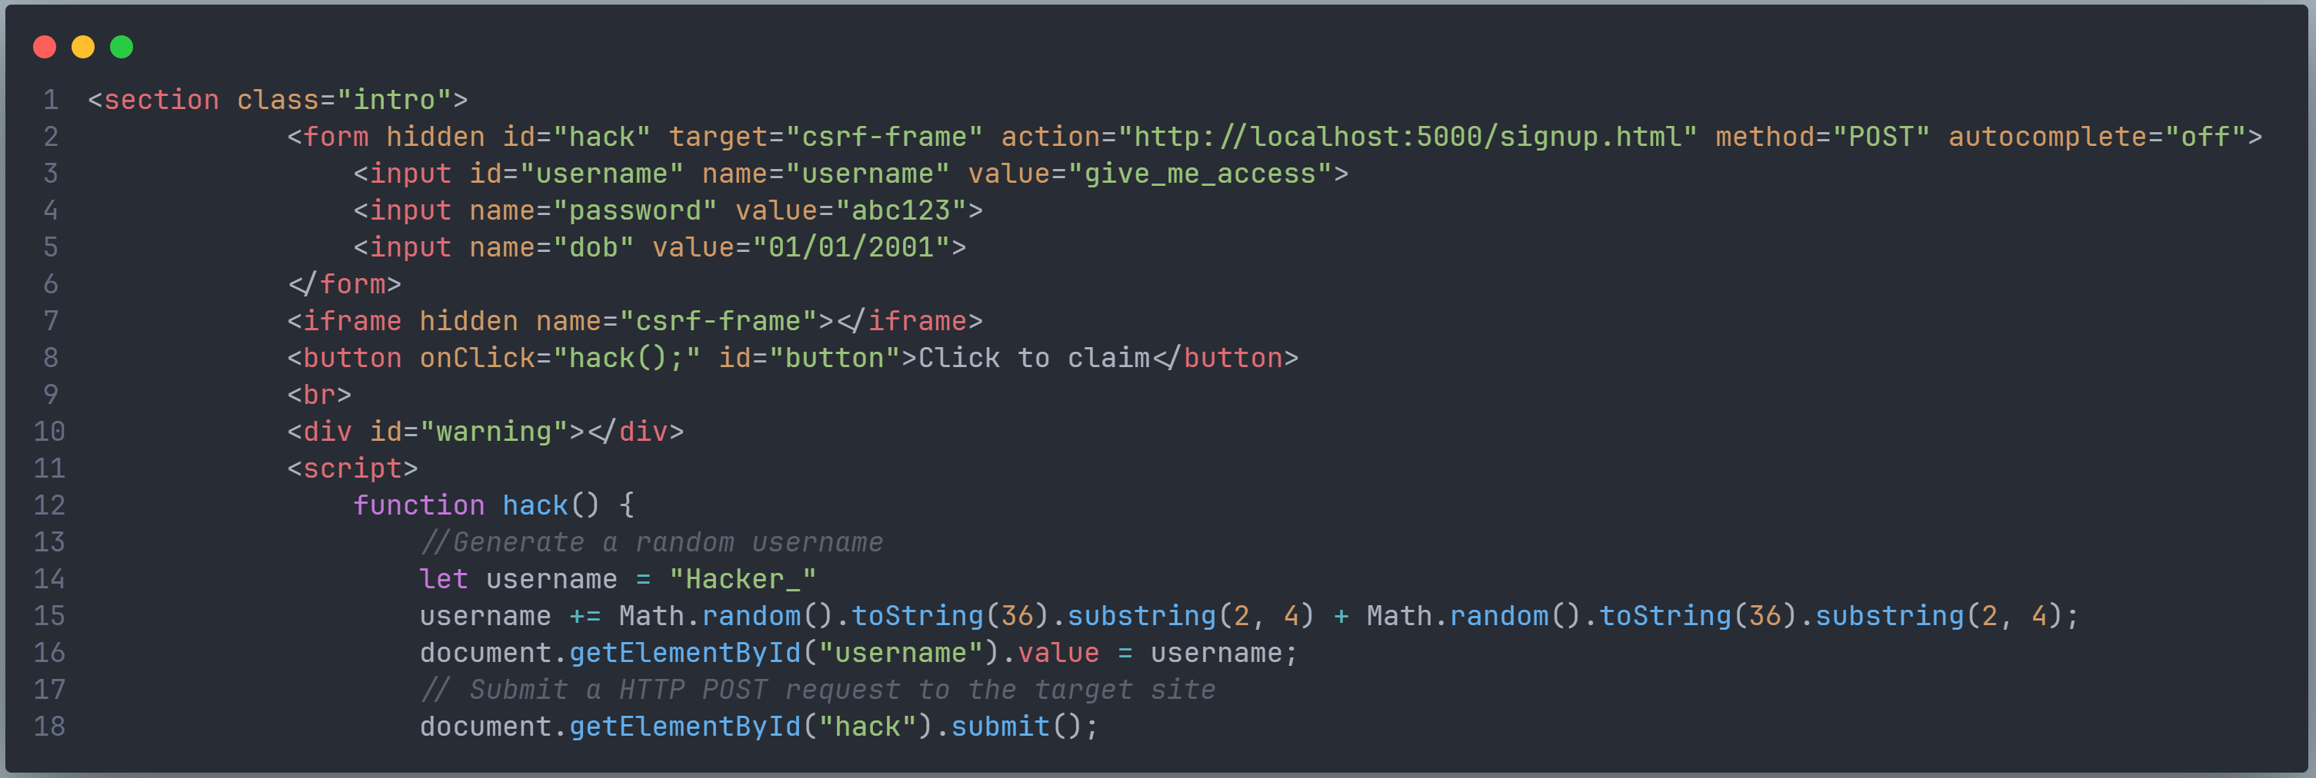
Cross-Site Request Forgery
Code
Code
Notes:
Explain how a CSRF can be easily concealed in a website or file attack.

Slide 47
Cross-Site Request Forgery
Countermeasures
Implement a synchronizer token pattern (STP) ie Flask WTForms.
Implement project authentication
End-user education.
Understand how the attack can be executed in the specific context of the application and user, then review the code with specific scenarios in mind.
Implement three-factor authentication (3FA) for administrative operations.
White-list firewall policies for example 1.1.1.2
Notes:
Discuss different countermeasures to CSRF

Slide 48
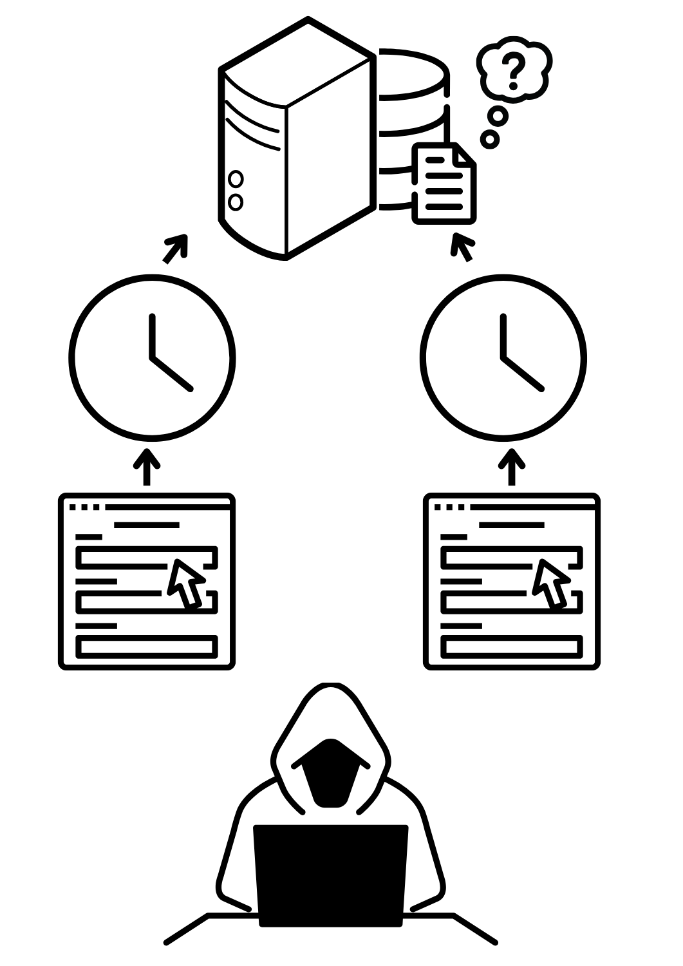
Race Conditions
Architecture
A threat actor will place the infrastructure underload with a DoS-style attack.
The threat actor makes multiple HTTP requests in parallel, such as repeatedly applying a discount coupon to a shopping cart in very quick succession.
The treat actor hopes to exploit an unmanaged thread schedule by effectively "racing" multiple HTTP requests to access/change shared data to their advantage.
Notes:
Explain race conditions, focusing on the racing concept between threads.

Slide 49
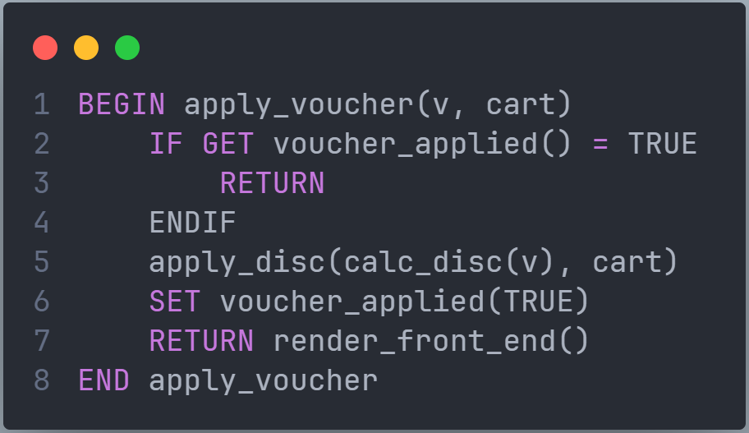
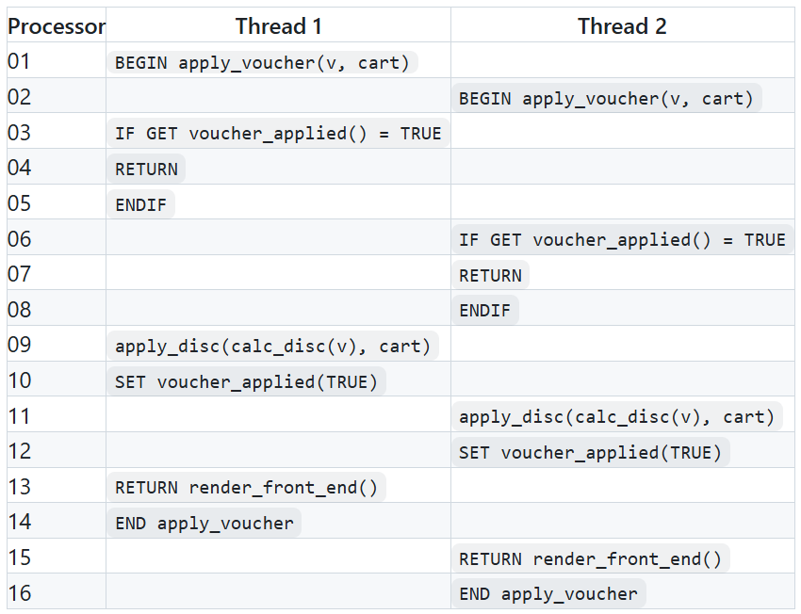
Race Conditions
Code
User controlled inputs
Notes:
Explain what it looks like at the code level when threads are racing.

Slide 50
Race Conditions
Countermeasures
Consider multithreading in any shared resource process, including (discounts, login processes, session ID creation, etc).
Implement a lock using the 'session ID' as a key in the algorithm, and most importantly, minimise the processing time between the lock's GET (or check) and SET.
Implement rate limiting.
Notes:
Discuss different countermeasures to Race Conditions.

Slide 51
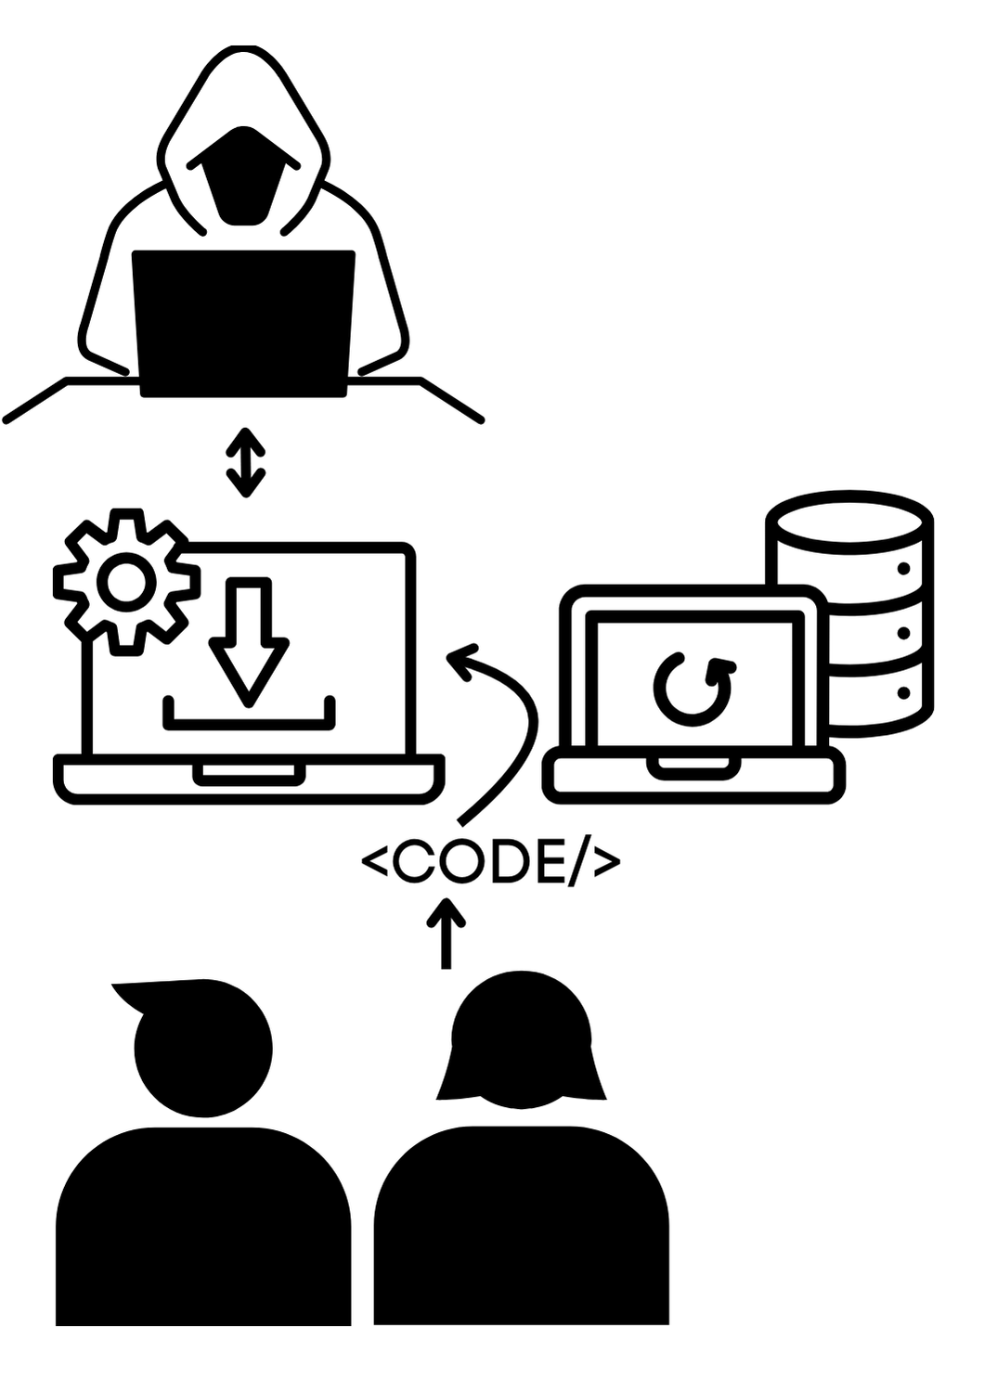
Invalid forwarding & redirects
Architecture
A threat actor exploits an invalid (or unvalidated) vulnerability to share a link that forwards the user to a different URL.
The share URL is easily masked and looks safe because the domain is a ‘familiar website.’
The victim follows a link that redirects them to a spoofed website, where the user enters data that the threat actor is able to intercept.
Notes:
Explain invalid forward and redirects focusing on how they make a malicious link look safe

Slide 52
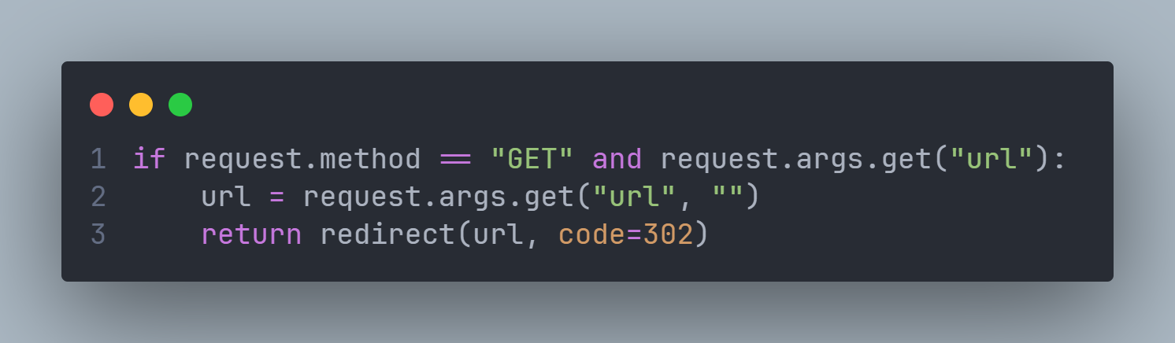
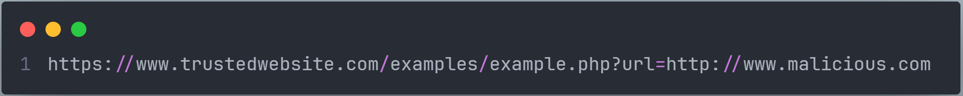
Invalid forwarding & redirects
Code
Notes:
Explain how an unvalidated URL redirect can be easily exploited

Slide 53
Invalid forwarding & redirects
Countermeasures
Code review
Explicitly declare the protocol, subdomain and domain as a minimum in the backend code and do not allow URLS to be manipulated by input.
Validate inputs, if a form requires URL's use regular expressions to explicitly define the URL specifications (HTTPS, subdomains, domains, paths and endpoints were possible) and exclusions ( >, <, ?, etc). This is particularly important if the input will be rendered on the front end or processed in the backend.
Update backend languages (early versions of asp.net are vulnerable)
Notes:
Discuss invalid forwarding and redirect countermeasures

Slide 54

Side Channel Attack
Architecture
A side-channel attack is any attack based on extra information that can be gathered because of the fundamental way a computer protocol or algorithm is implemented.
Leaking data includes:
Time
Cache
Power/electromagnetic/thermal energy, etc
Frequency outputs
Exception response
Error response
Notes:
Explain what side-channel attacks are.

Slide 55
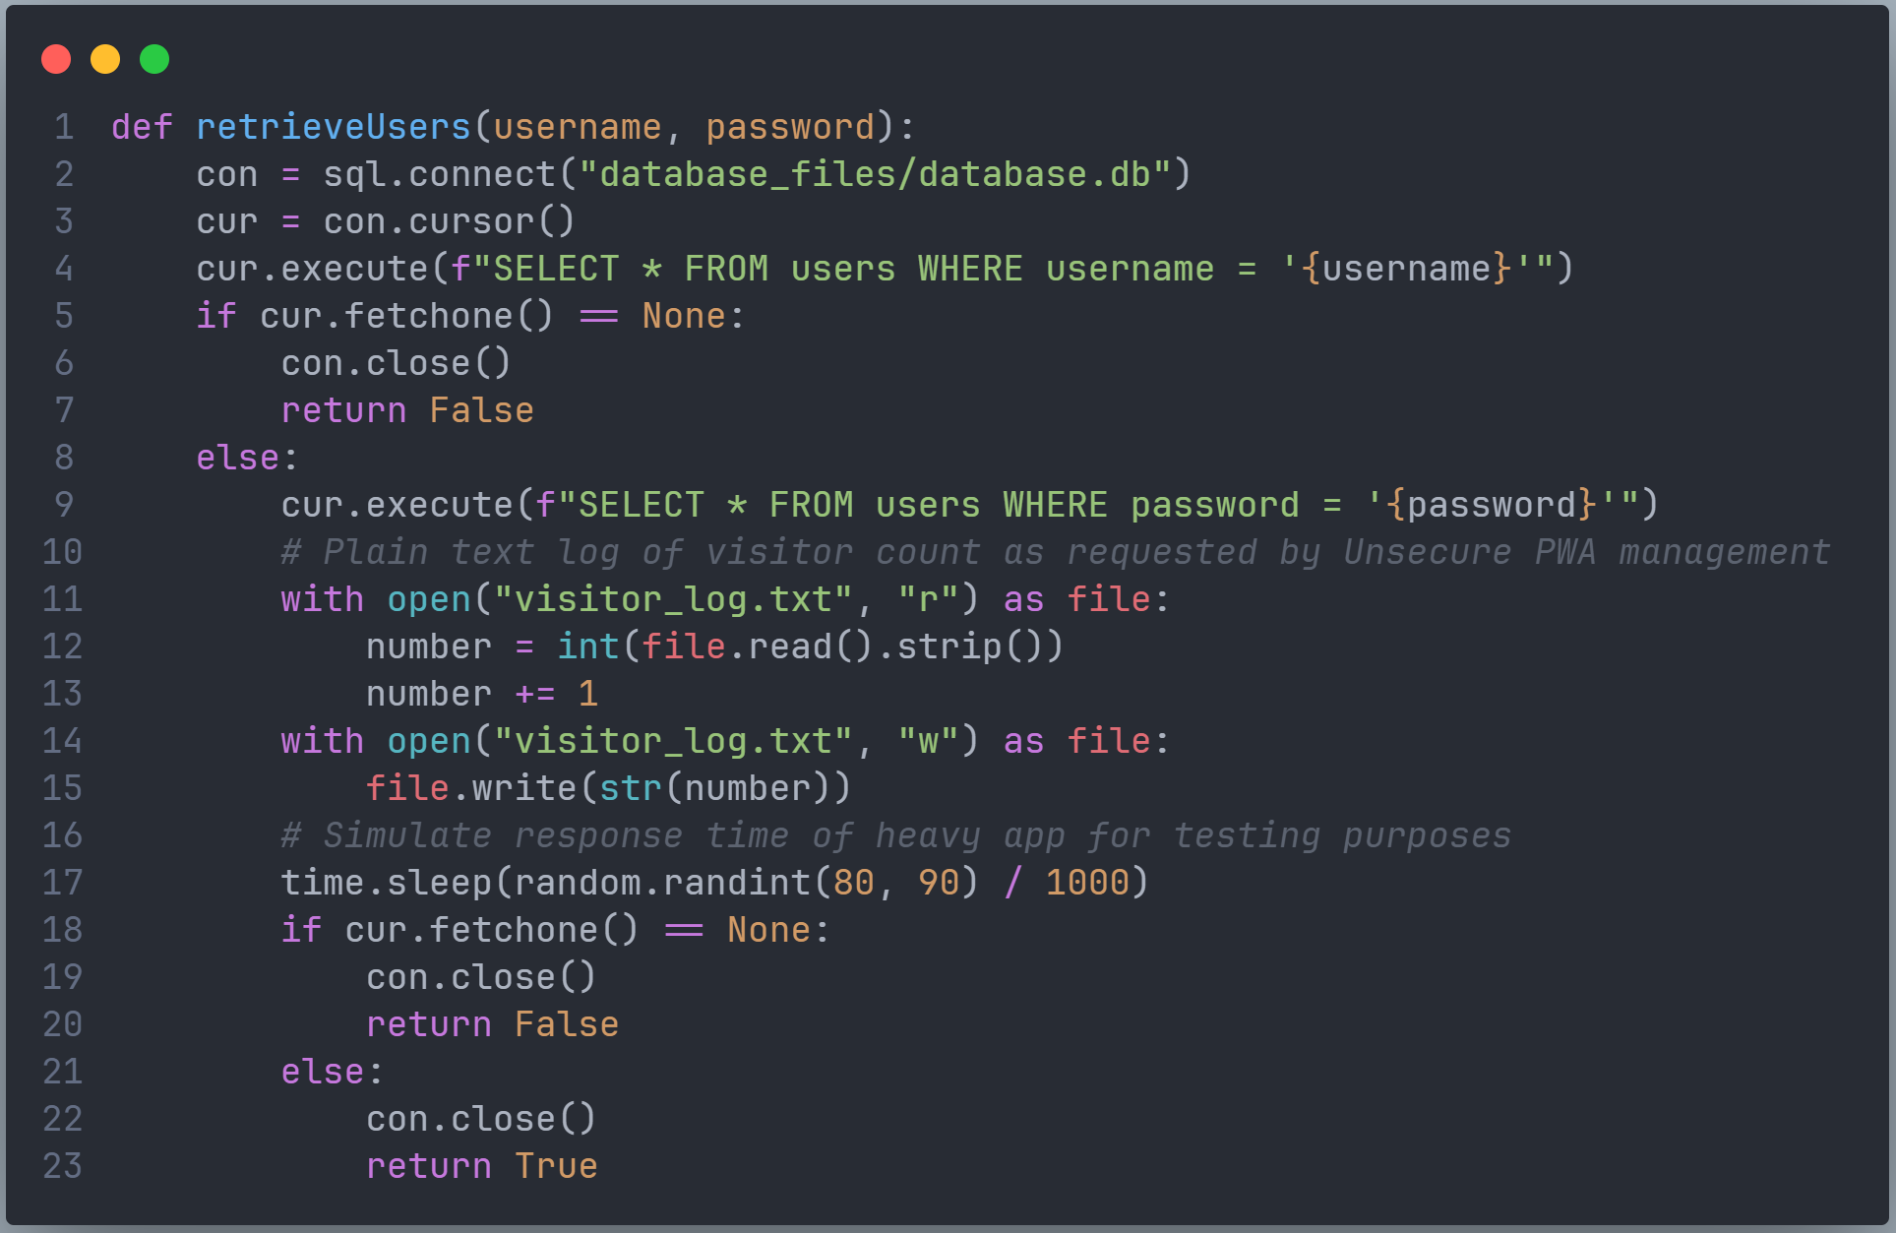
Side Channel Attack
Code
A side-channel attack breaks cryptography by exploiting information inadvertently leaked by a system when performing cryptography.
Students should not be expected to identify specific code samples but rather identify when code can provide different conditions when the response outcome is the same.

Slide 56
Side Channel Attack
Countermeasures
Understand how the attack can be executed in the specific context of the application and user, then code review with specific scenarios in mind.
Randomise operations and data access patterns for all cryptography processes
Introduce noise through random micro delays
Isochronous functions so the software runs for an exactly constant amount of time, independent of secret values.
Implement tighter rate limiting on login pages. For example, install and configure Flask Limiter
Notes:
Explain side channel countermeasures

Slide 57
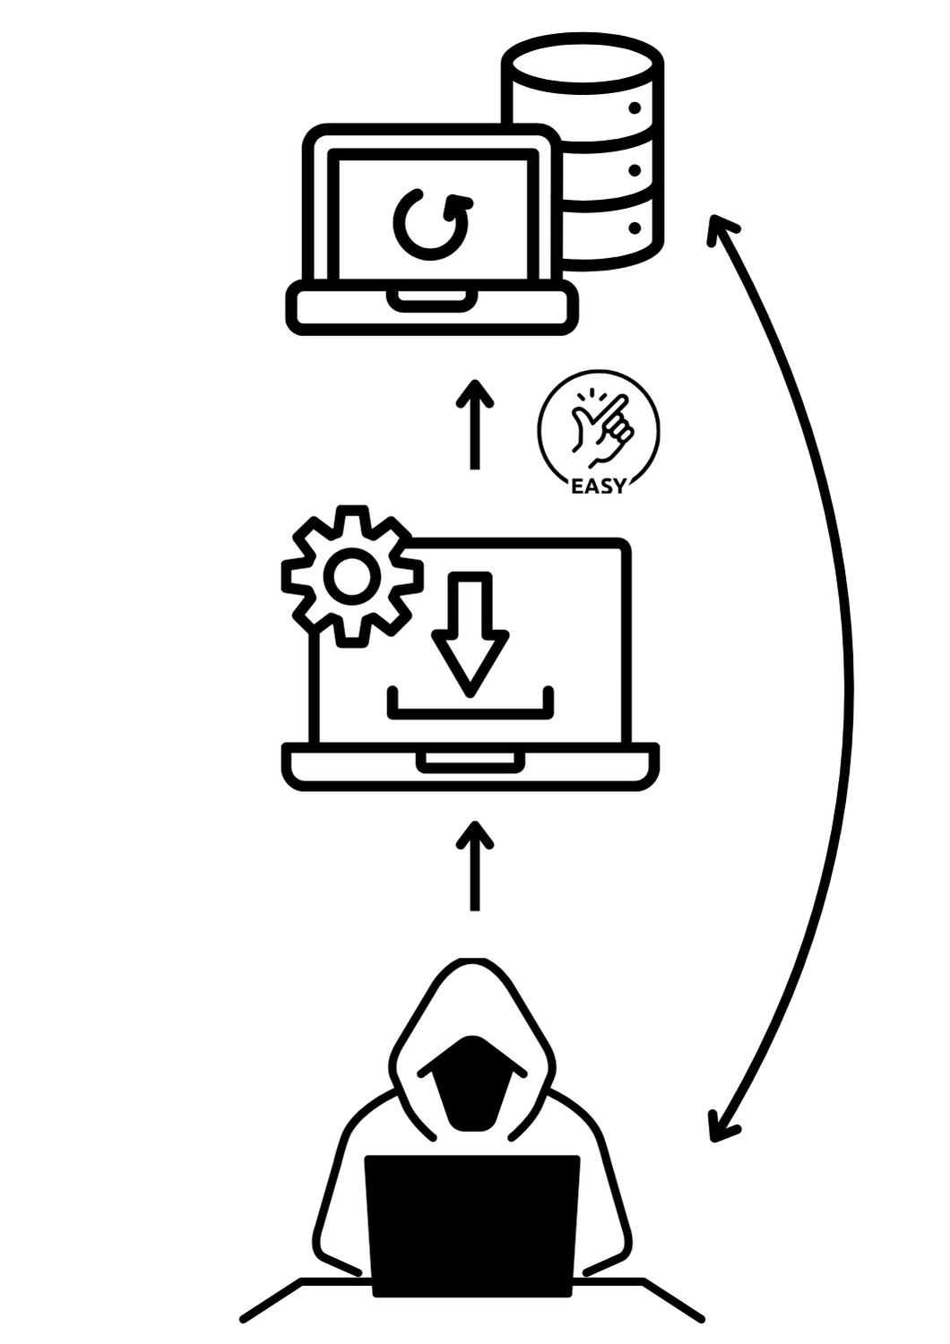
Broken Session Management
Architecture
The session management algorithm is ‘broken’, allowing easy authenticated access to a system. It is a very broad vulnerability with multiple attack vectors.
Session persistence between users
Cookies can be copied and reused
No session management
Easily brute forced session key
Easily calculated session key
No ‘project’ authentication to API
etc
Notes:
Explain the vulnerability and the architecture of session persistence and cookie theft.

Slide 58
Broken Session Management
Countermeasure
Implement a secure, server-side session management system that creates a new, random session ID with high complexity each time someone logs in.
Ensure the session ID is not visible in the web page's URL, is kept safe, and is properly discarded following a user's logout, periods of inactivity, or after session timeouts.
For example, install and configure Flask Session
Conduct regular security audits and testing.
Notes:
Discuss broken session countermeasures.

Slide 59
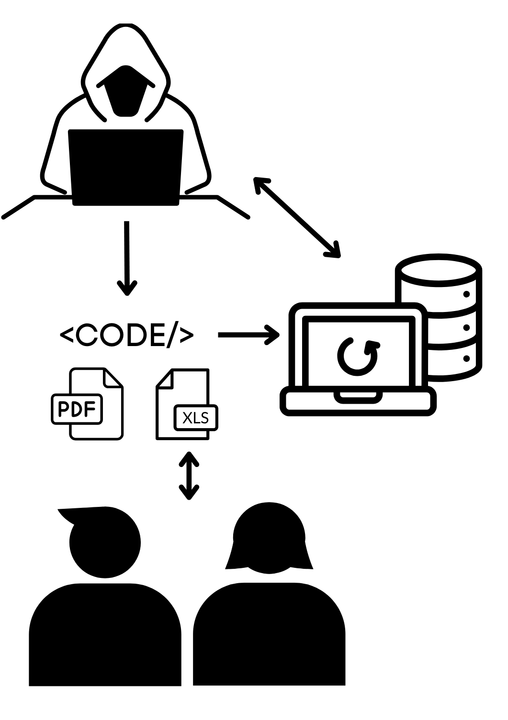
File Attack
Architecture
. A file (usually an Excel Macro *.xlsm or a PDF with Javascript) is either sent to a user or placed on a honeypot website and downloaded by a user.
The file is open, and the malicious script (Javascript, Visual Basic, Python, etc.) is executed on open or when an action is performed in the document.
The malicious code could:
Install a more malicious program (key logger, screen sharing, etc)
Change DNS settings
POST data from active website UI to another website
Steel cookies or session data
Perform state-changing processes on install systems
Notes:
Explain side channel countermeasures

Slide 60
File Attack
Countermeasures
Countermeasure common vulnerabilities
Cross Frame Scripting - XFS
Cross Site Request Forgery - CSRF
Cross Site Scripting - XSS
Broken Authentication and Session Management.
Implement Two Factor Authentication - 2FA.
End user education
White-list firewalls
Application control policies
Notes:
Explain side channel countermeasures

Slide 61
Practical software security activities

Slide 62
Learning intentions and success criteria
Session 4 – Implementing 2FA
We are learning to:
implement code that considers security factors
implement secure code that minimises vulnerabilities in user action controls including broken authentication
We can:
Mitigate against broken authentication and session management
Implement code for defensive data input handling practices
Notes:
Overview the learning intentions and success criteria for the session

Slide 63
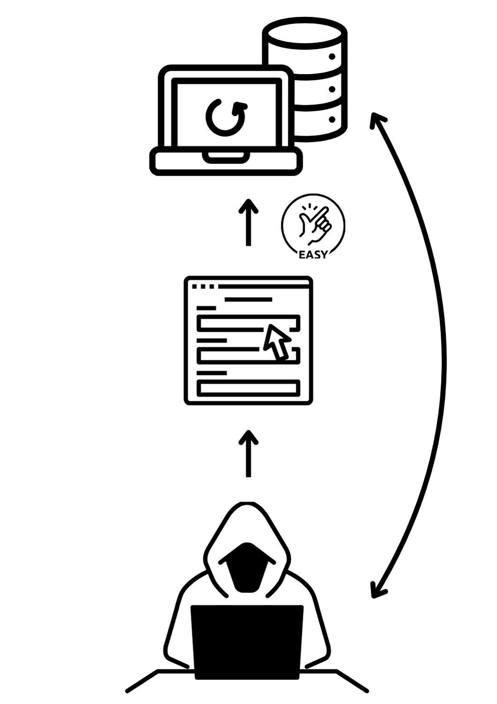
Broken Authentication
Architecture
The authentication algorithm is ‘broken’, allowing easy authenticated access to a system. It is a very broad vulnerability with multiple attack vectors.
SQL Injection
No password complexity requirements
Brute force forgotten password
Known usernames and passwords allow brute force dictionary attack
No 2FA
etc
Notes:
Explain broken authentication and the architecture of brute forcing/dictionary attacks

Slide 64
Broken Authentication
Countermeasures
Enforce strong passwords.
Event logging and log analysis.
Implement a secure, server-side session management system that creates a new, random session ID with high complexity each time someone logs in. For example, install and configure Flask Session
Implement two-factor authentication.
Conduct regular security audits and testing.
Implement strong rate limiting for a login page. For example, install and configure Flask Limiter.
Salt and hash passwords.
Notes:
Discuss counter measures for broken authentication.

Slide 65

Implementing 2FA
QR Code + Google Authenticator + Flask
Requirements:
Device with Google Authenticator (tablet or smartphone)

Slide 66

Implementing 2FA
QR Code + Google Authenticator + Flask
Requirements:
qrcode
Pyotp - is a Python library for generating and verifying one-time passwords. It can be used to implement two-factor (2FA) or multi-factor (MFA) authentication methods in web applications and in other systems that require users to log in.

Slide 67
Implementing 2FA
QR Code + Google Authenticator + Flask
os - provides functions for interacting with the operating system.
base64 – used to encode strings in Python
BytesIO – used to manage and deal with Unicode characters
Note:
Every time you compile and run the code you need to update the QRCode image (within the app) and rescan the QRCode in the app

Slide 68
Implementing 2FA
QR Code + Google Authenticator + Flask
Alternatives
Email (Twilio)
Implementing in Visual Studio Code
Adding 2FA to the PWA we have created so far.

Slide 69
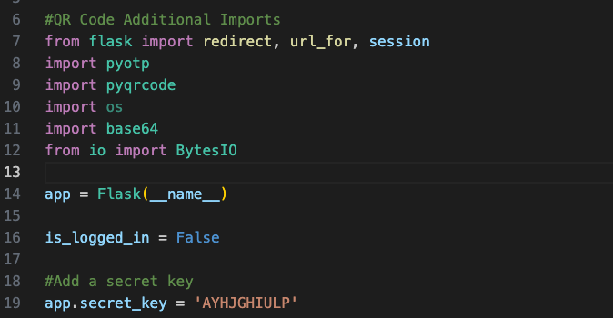
Implementing 2FA: QR Code + Google Authenticator + Flask
Adding in the additional imports required for the QRCode functionality.
Line 19: We also need to add a secret key which is used in the generation of the QRCode.

Slide 70
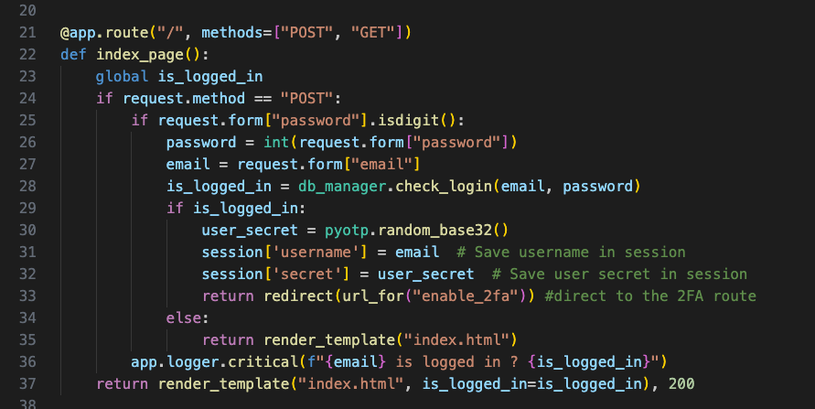
Implementing 2FA: QR Code + Google Authenticator + Flask
Update the "/" route to redirect to the authentication page and create a session for the user (line 31 and 32)

Slide 71
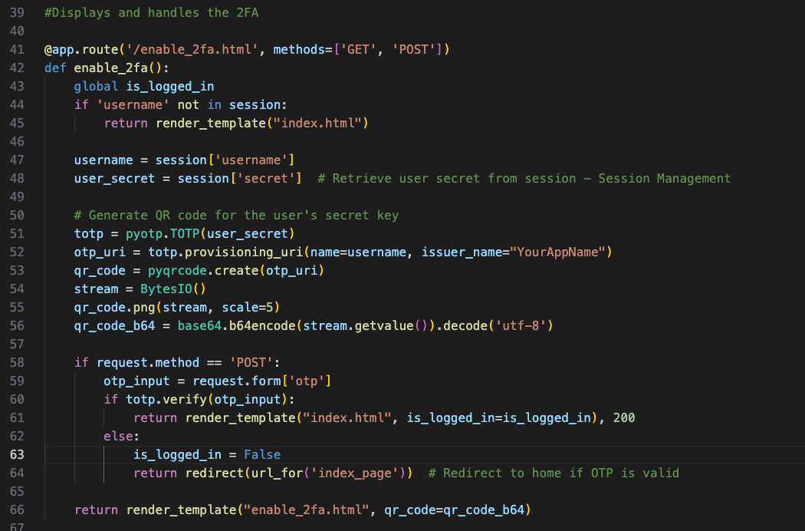
Implementing 2FA: QR Code + Google Authenticator + Flask

Slide 72

Implementing 2FA: QR Code + Google Authenticator + Flask

Slide 73
GitHub and Flask

Slide 74

GitHub
Demo
Code hosting
Version control
Collaboration tools
Static web hosting
Codespaces - VSCode in the cloud
Student portfolios
Static application security testing
GitHub Schools: https://github.com/education/schools
GitHub Teachers: https://github.com/education/teachers
GitHub Students: https://github.com/education/students

Slide 75
Cyber security presentation

Slide 76
Evaluation and close

Slide 77
Copyright
© State of New South Wales (Department of Education), 2024
The copyright material published in this resource is subject to the Copyright Act 1968 (Cth) and is owned by the NSW Department of Education or, where indicated, by a party other than the NSW Department of Education (third-party material).
Copyright material available in this resource and owned by the NSW Department of Education is licensed under a Creative Commons Attribution 4.0 International (CC BY 4.0) licence.
This licence allows you to share and adapt the material for any purpose, even commercially.
Attribution should be given to © State of New South Wales (Department of Education), 2024.
Material in this resource not available under a Creative Commons licence:
the NSW Department of Education logo, other logos and trademark-protected material
Material owned by a third party that has been reproduced with permission. You will need to obtain permission from the third party to reuse its material.
Links to third-party material and websites
Please note that the provided (reading/viewing material/list/links/texts) are a suggestion only and implies no endorsement, by the New South Wales Department of Education, of any author, publisher, or book title. School principals and teachers are best placed to assess the suitability of resources that would complement the curriculum and reflect the needs and interests of their students.
If you use the links provided in this document to access a third party’s website, you acknowledge that the terms of use, including licence terms set out on the third-party’s website apply to the use which may be made of the materials on that third-party website or where permitted by the Copyright Act 1968 (Cth). The department accepts no responsibility for content on third-party websites.

